Slide 1
BCCA figures
March 13 2025

Slide 2
Data % to report
X2.1.Flow.Type n prop
<chr> <int> <dbl>
1 Biotic 113 0.551
2 Human movement 21 0.102
3 Physical 38 0.185
4 Sociocultural 33 0.161

Slide 3
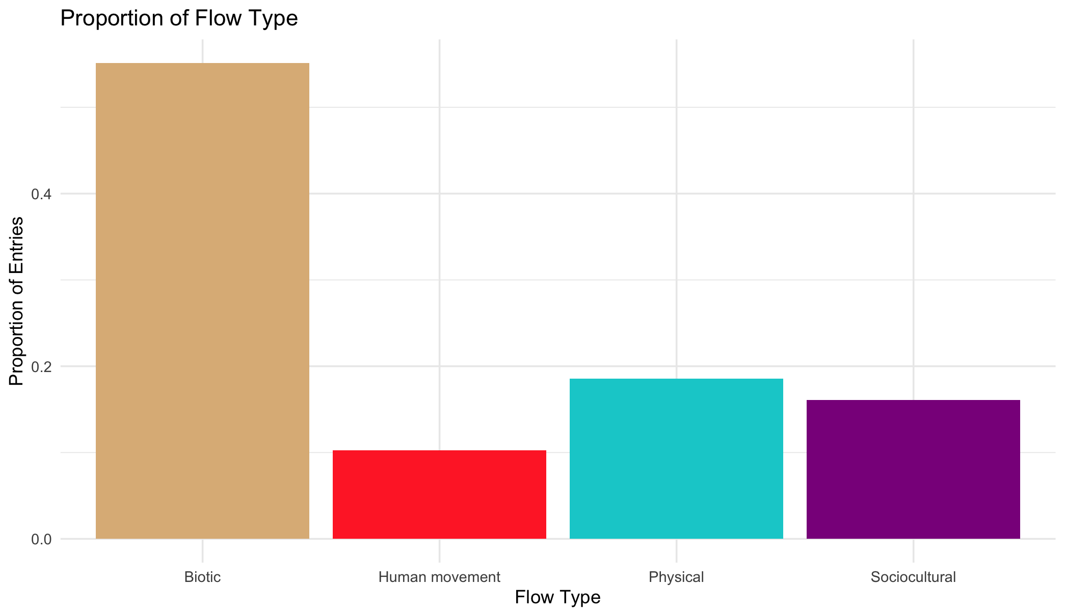

Slide 4
Multiple flows
Another.Flow. n prop
1 No 168 0.820
2 Yes 37 0.180

Slide 5
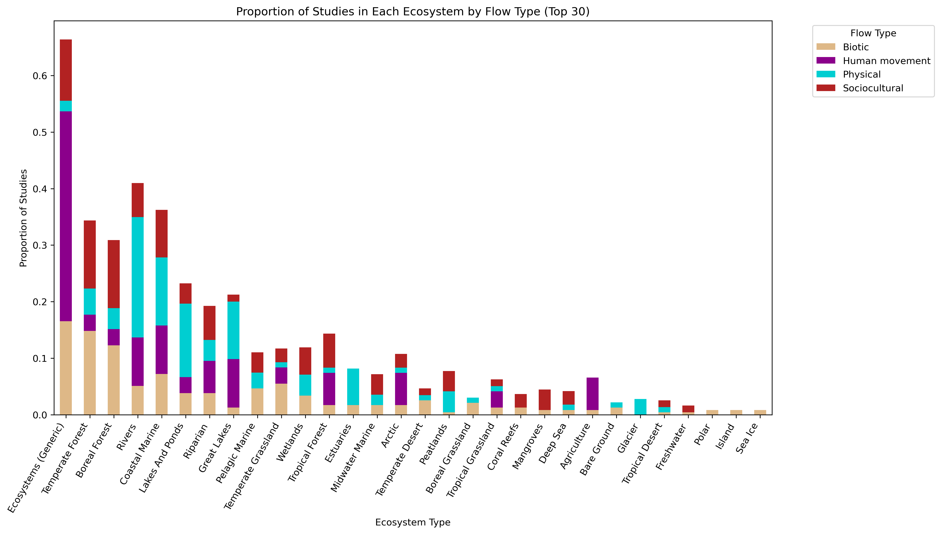
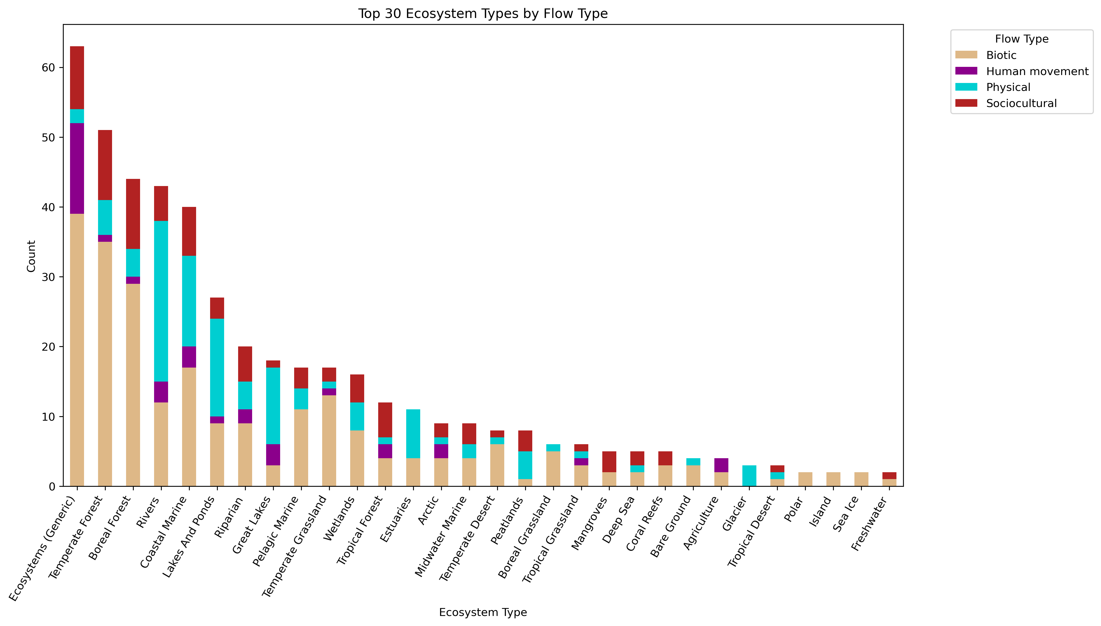

Slide 6
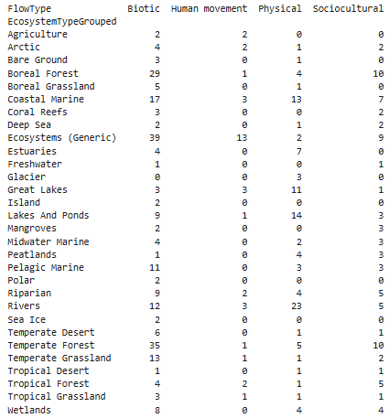
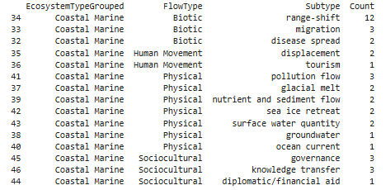

Slide 8
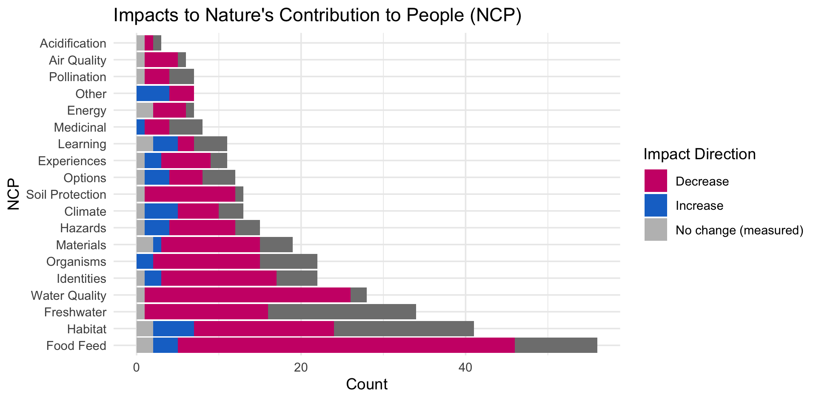

Slide 10
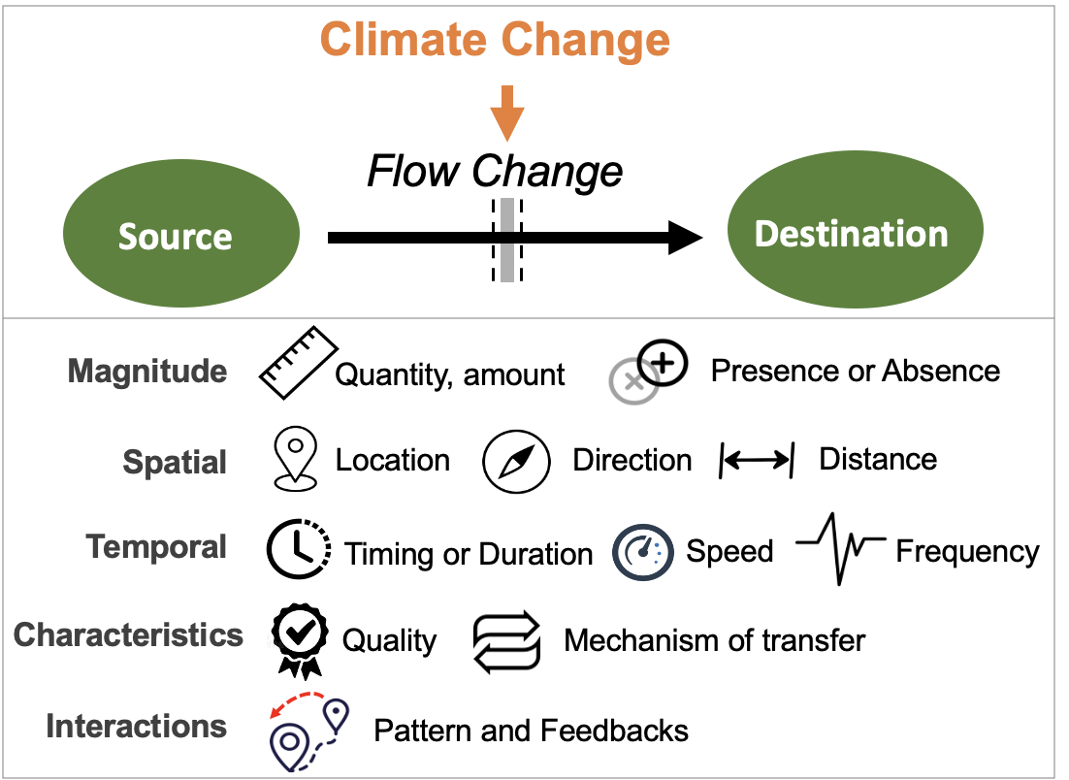
Most common paths
Climate change →

Slide 11
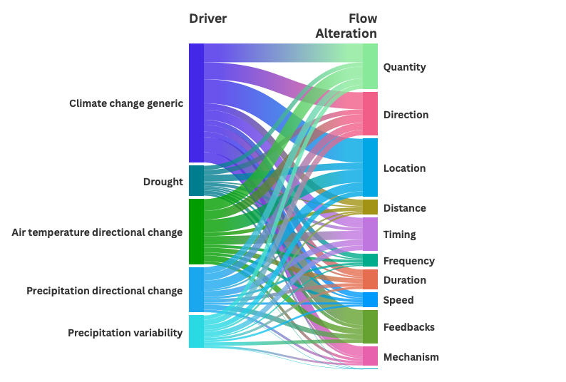

Slide 12
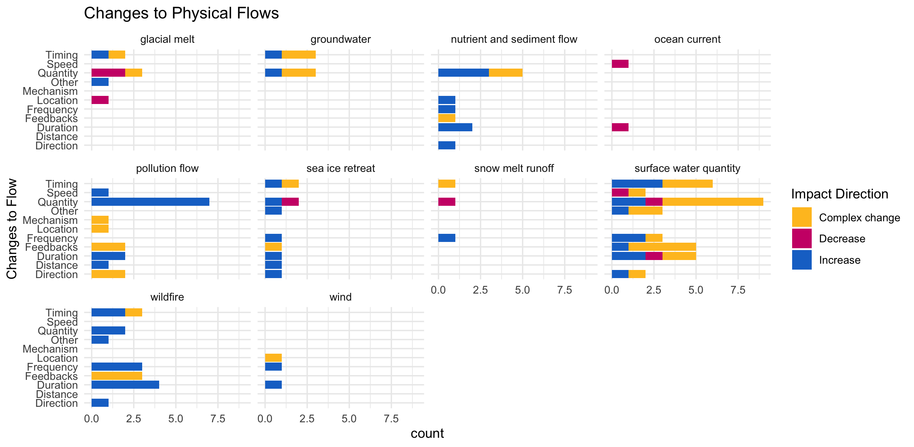

Slide 13
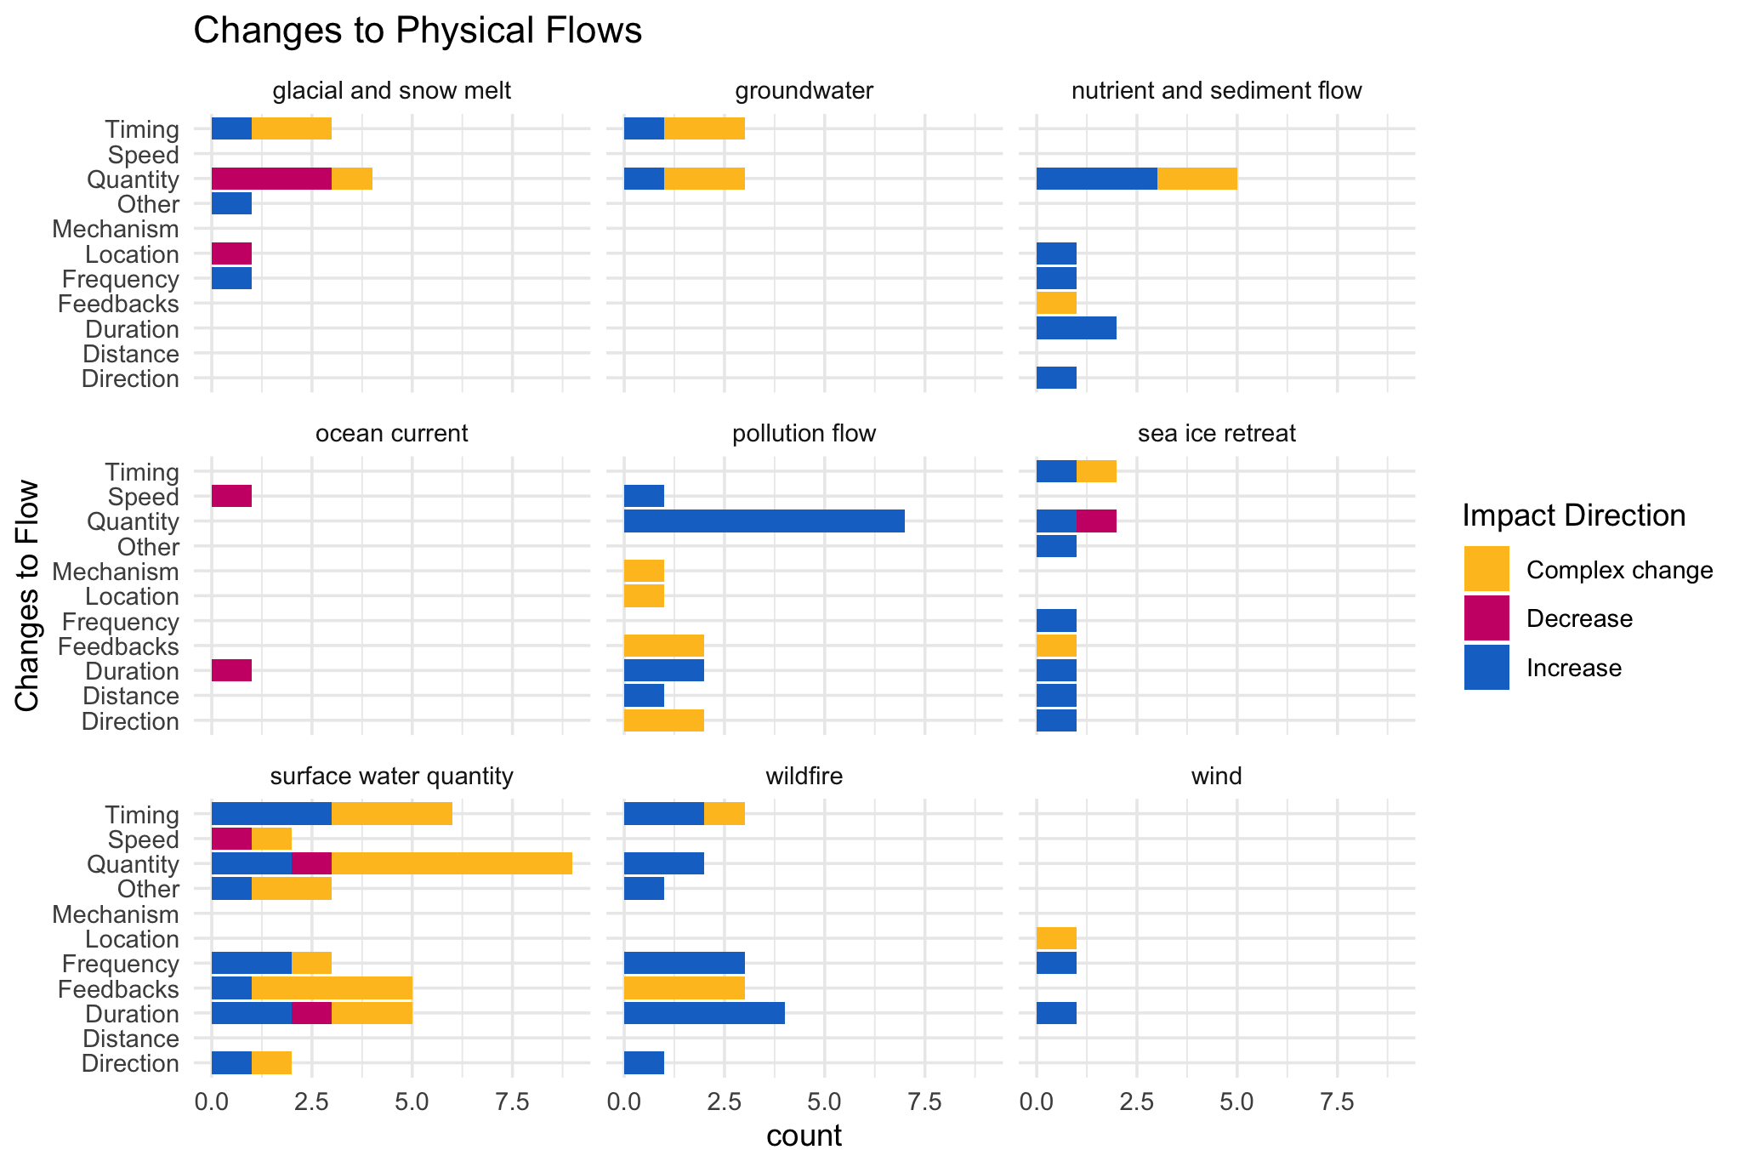

Slide 14
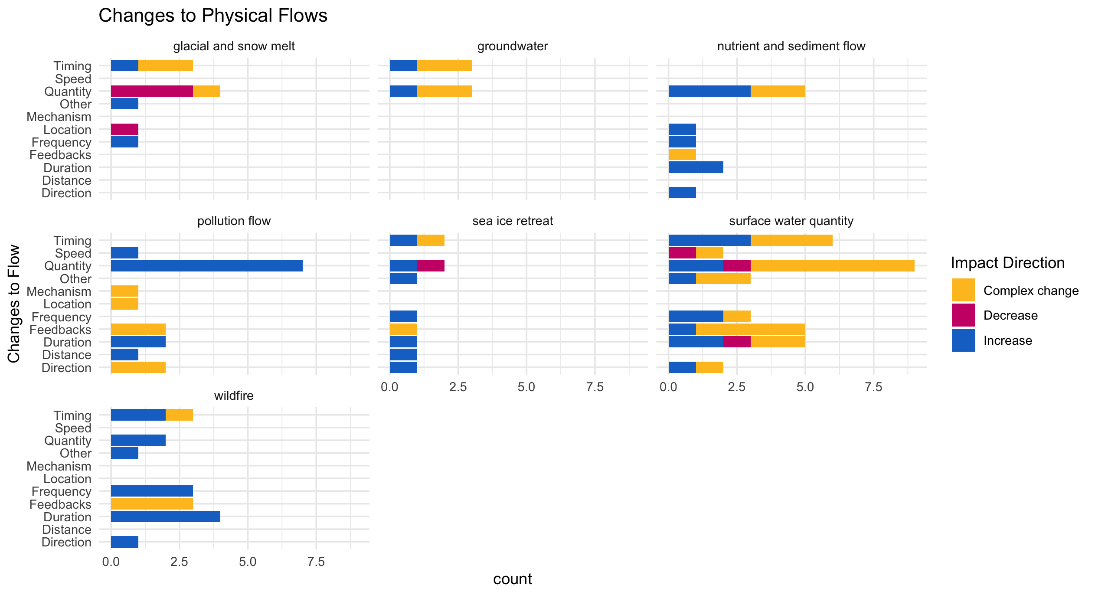

Slide 15
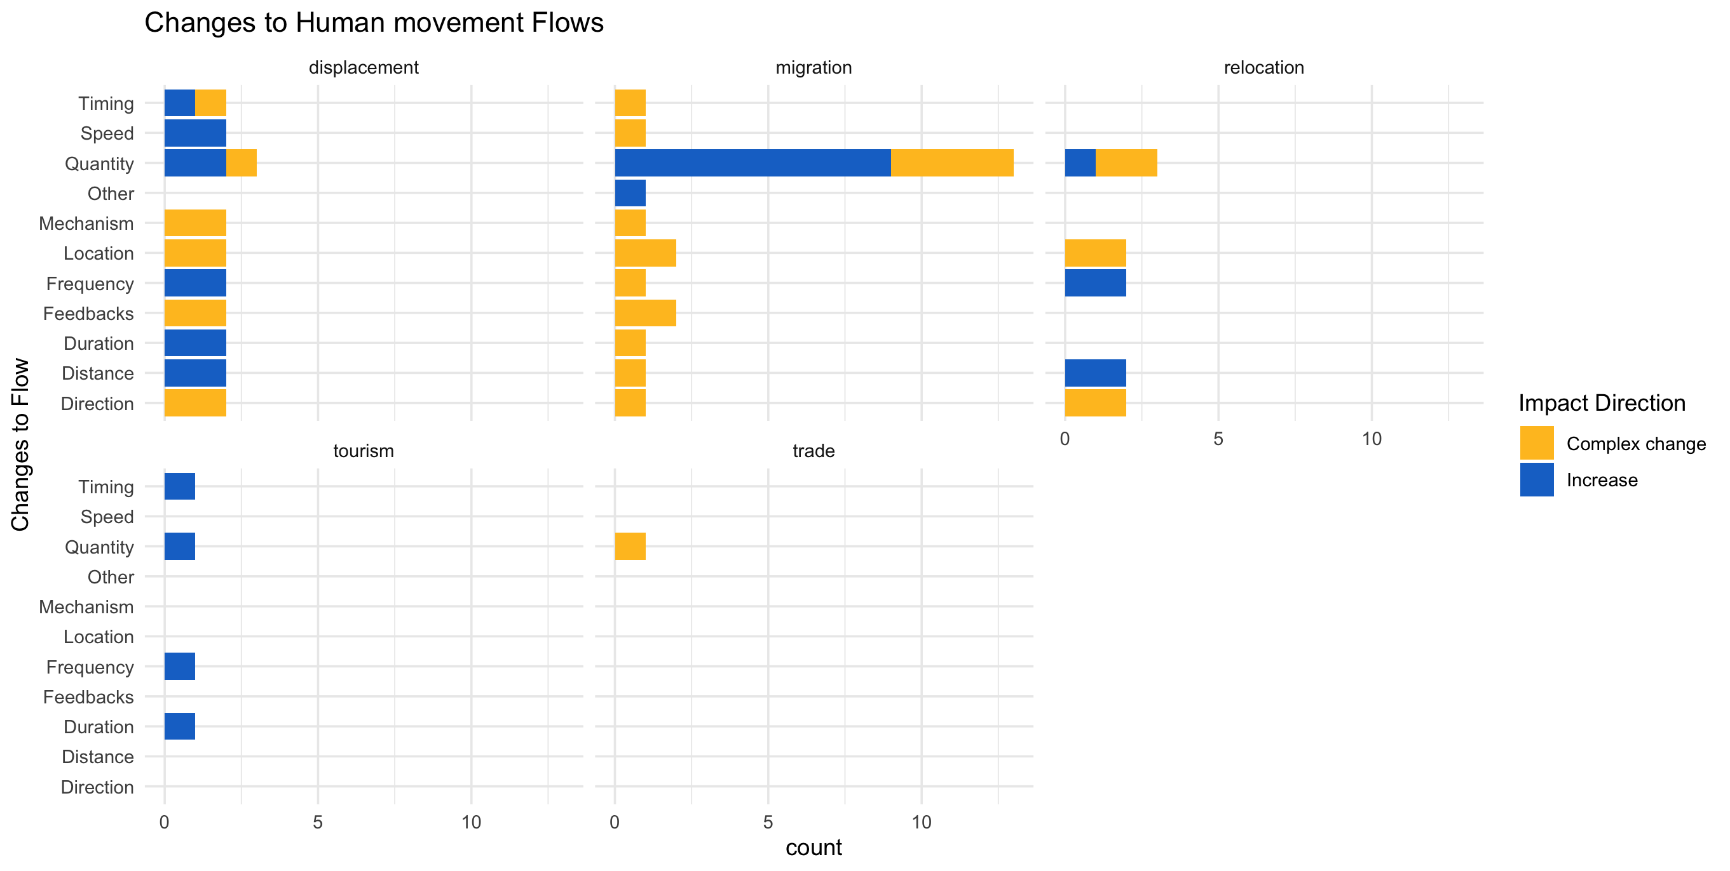

Slide 16
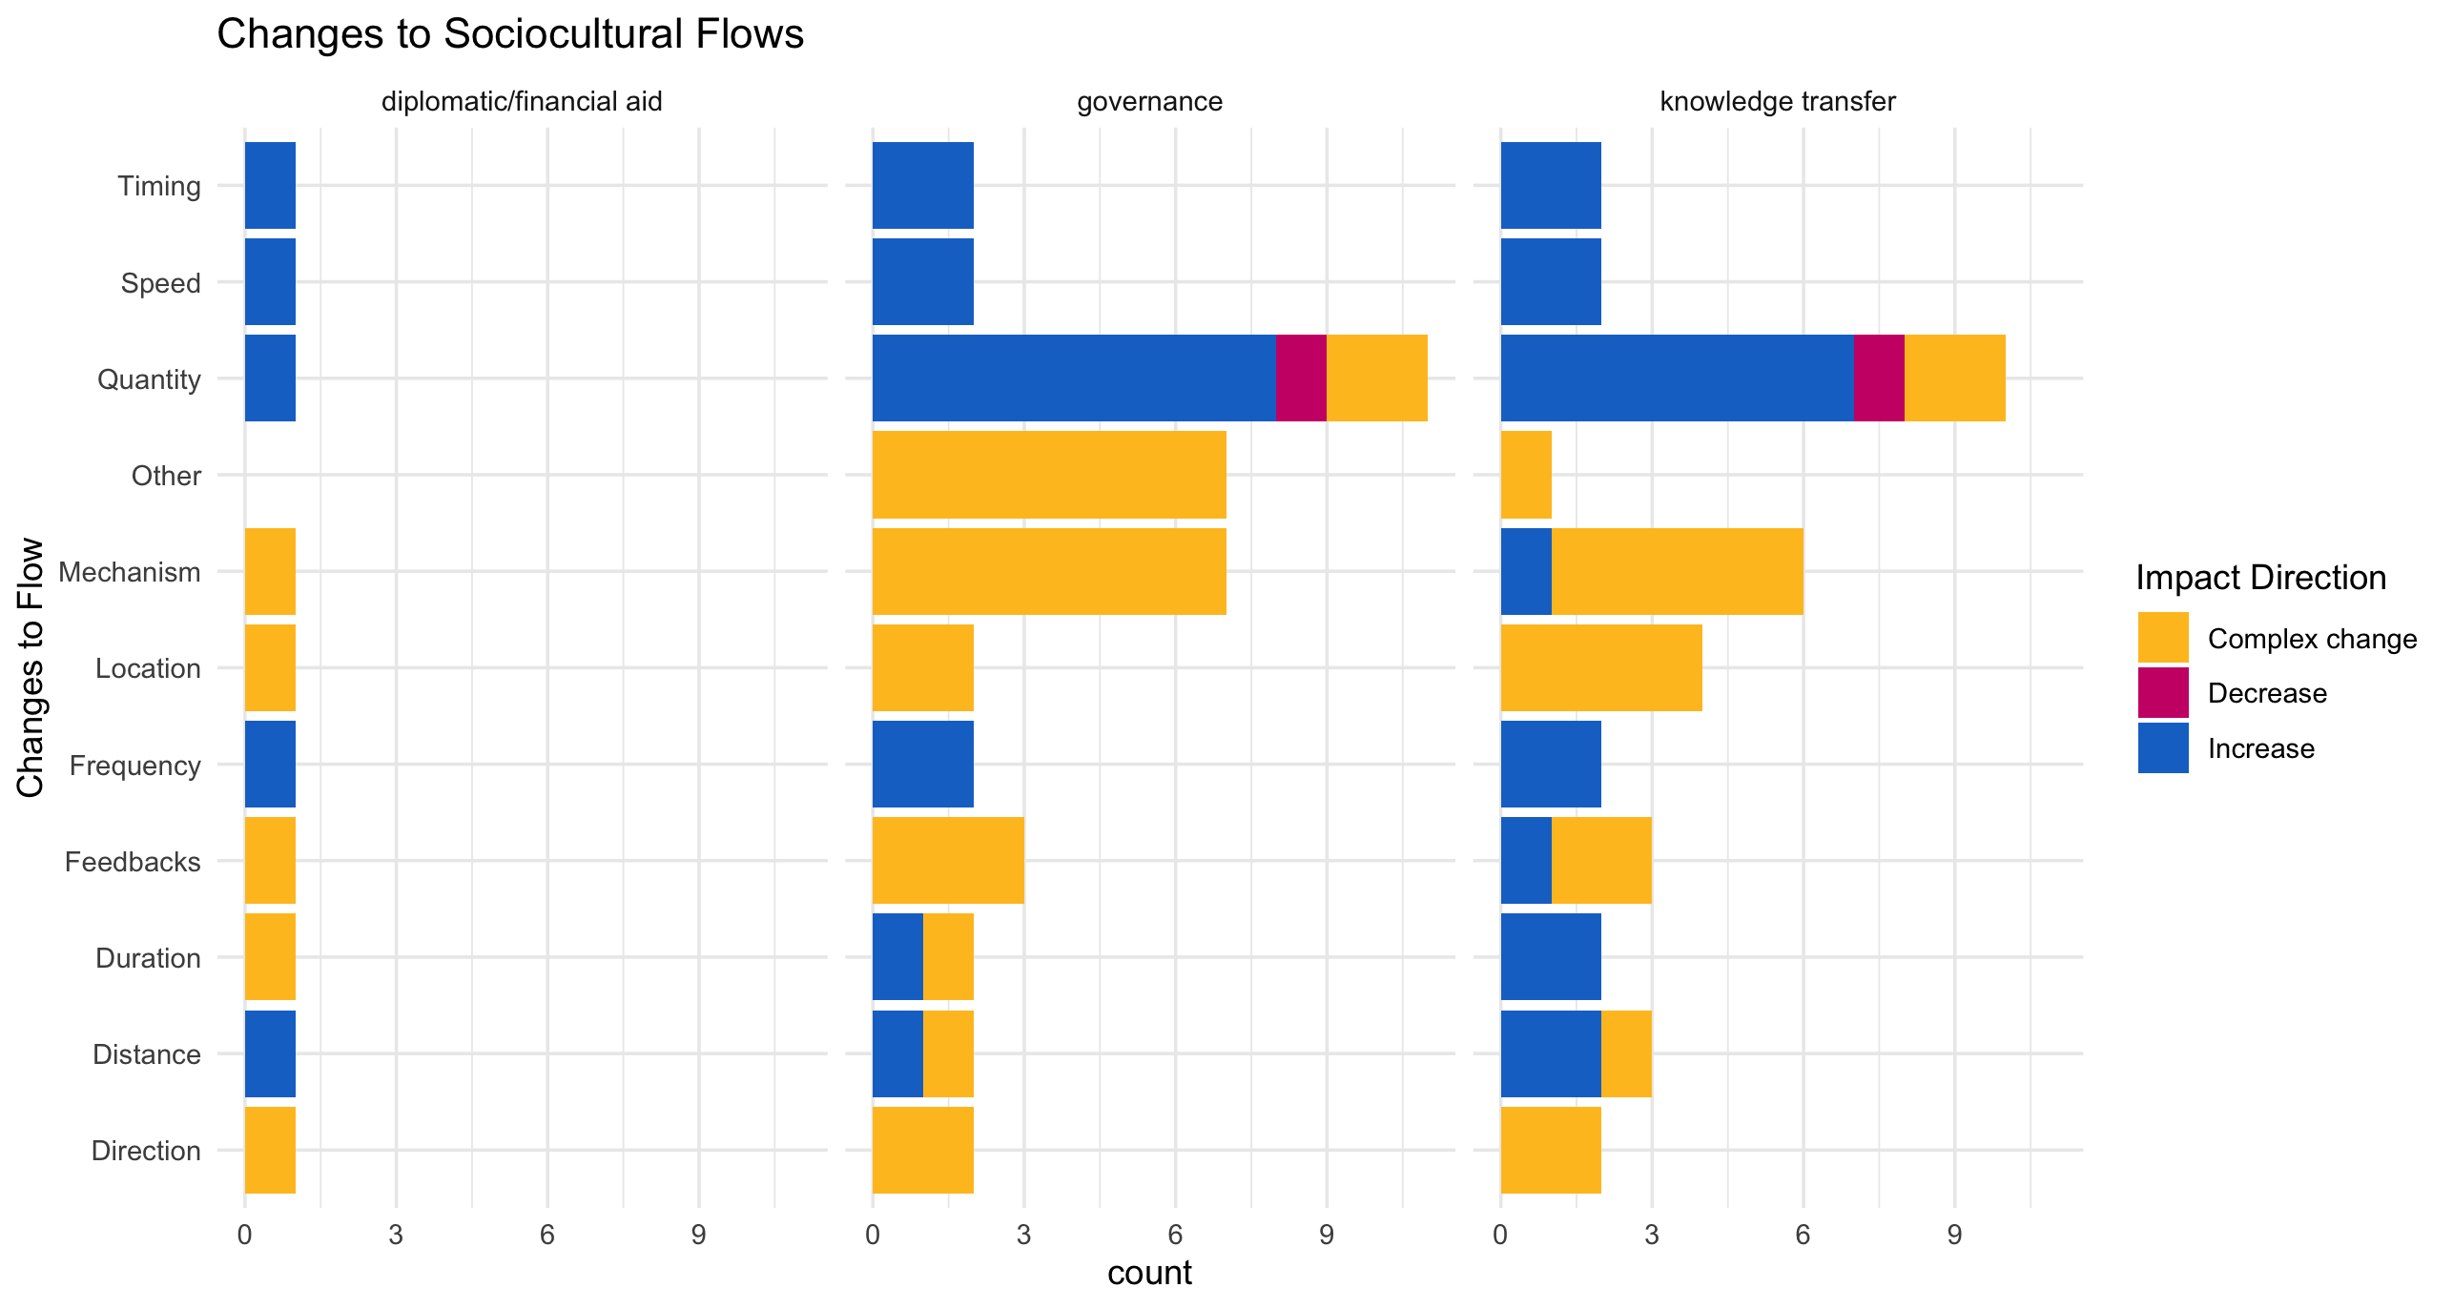

Slide 17
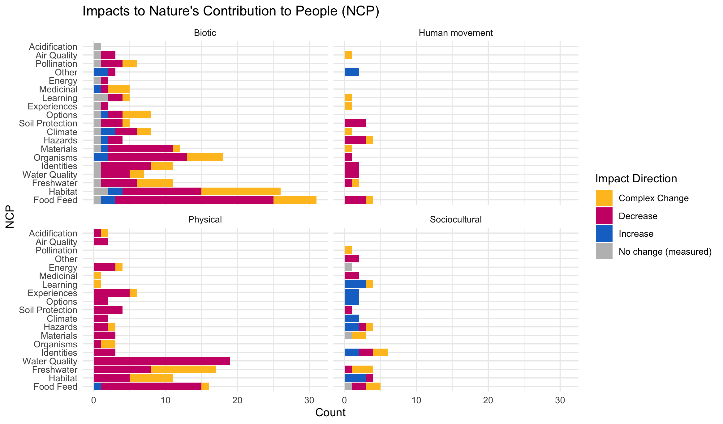

Slide 18
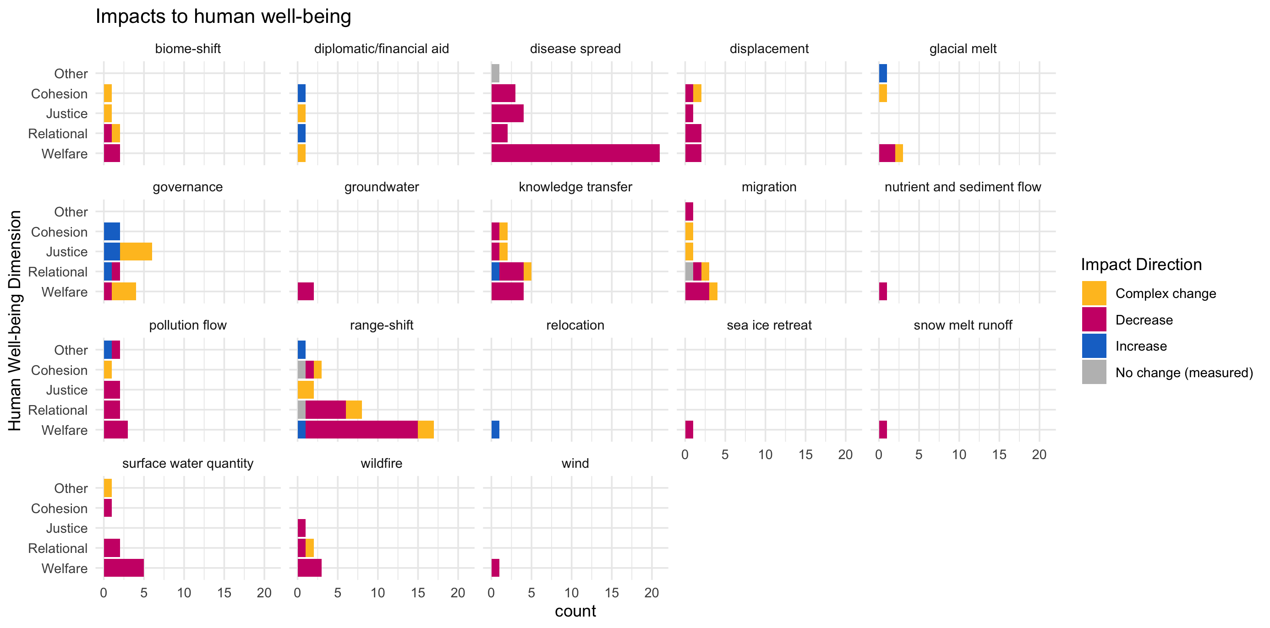

Slide 19
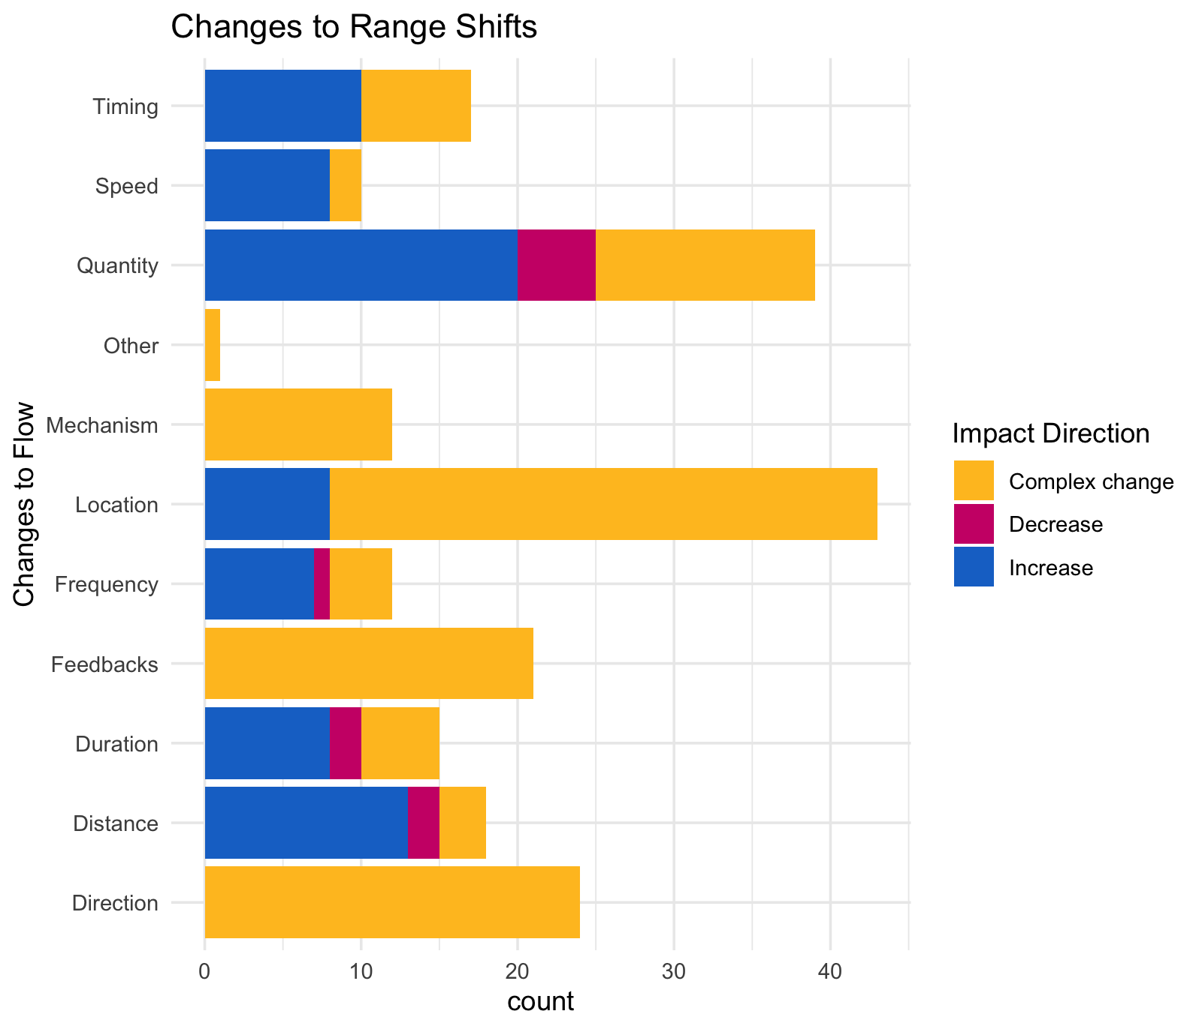

Slide 20
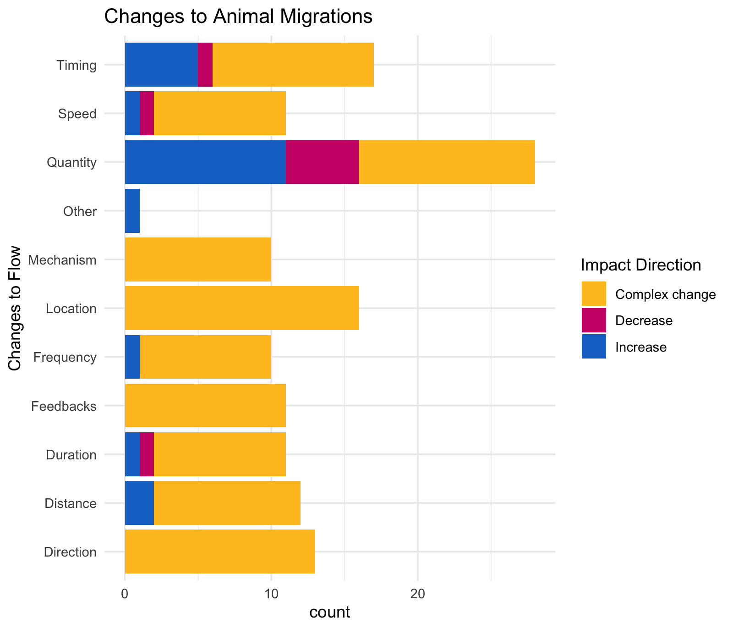

Slide 21
OLDER:

Slide 23
At least 5 entries – top – to get stats on % of entries or papers on these:

Slide 24
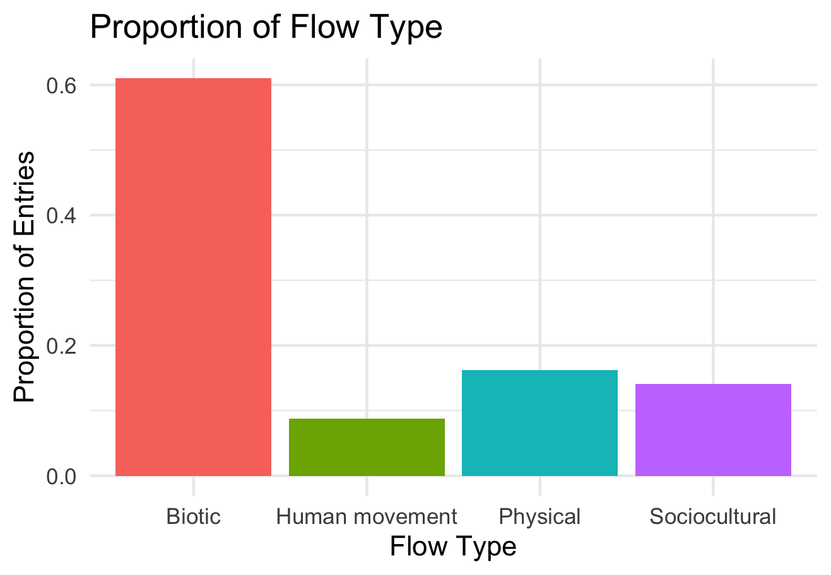

Slide 25
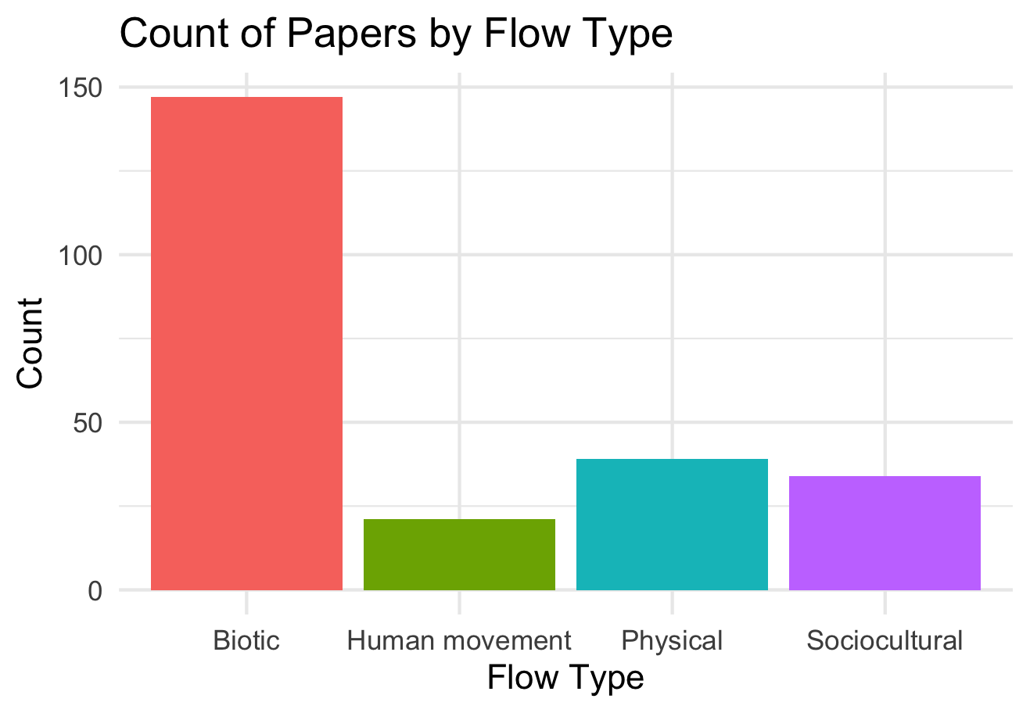

Slide 26
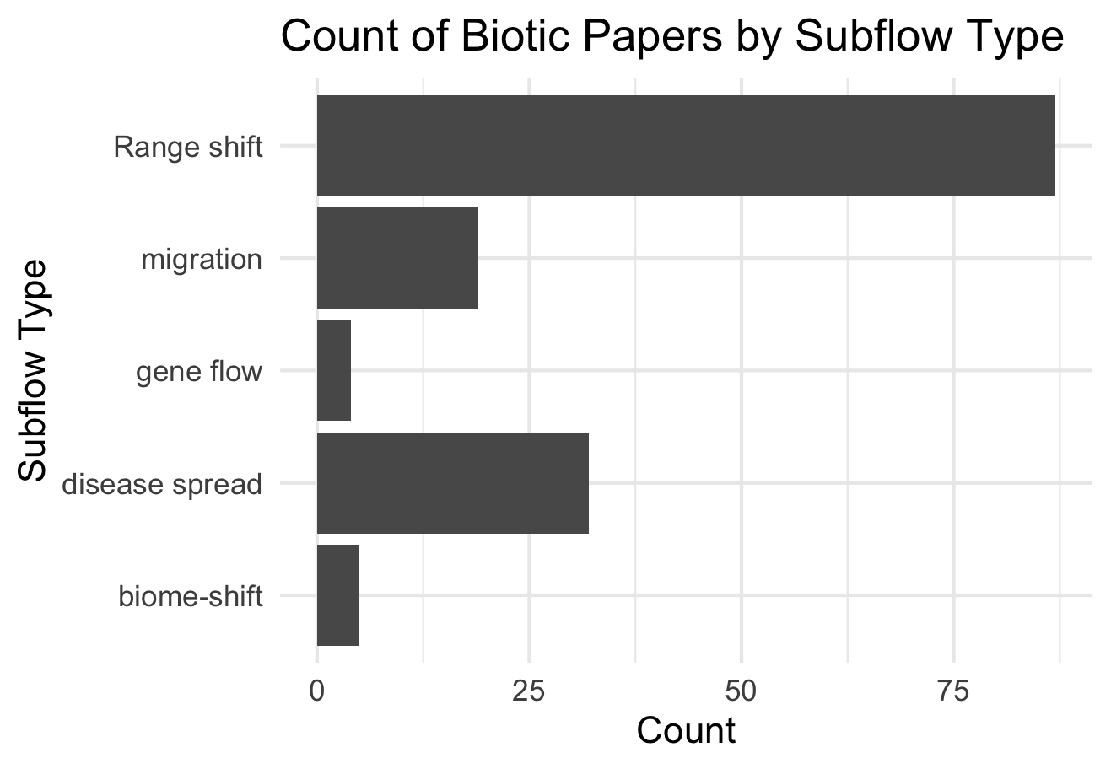

Slide 27
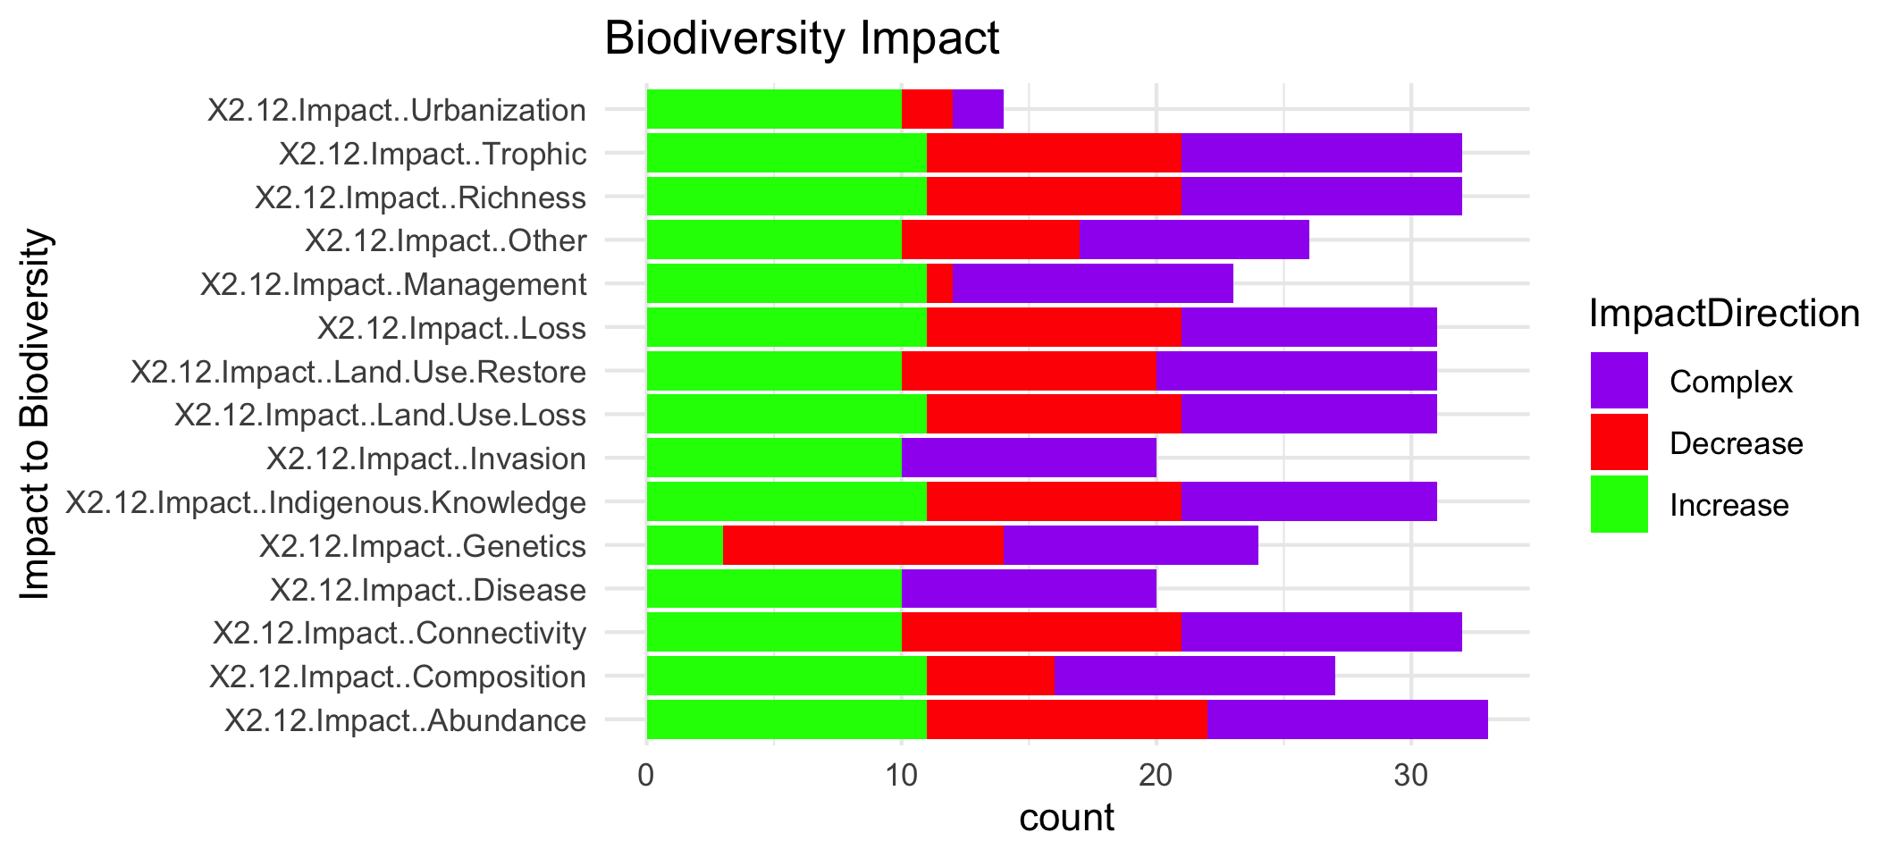

Slide 29
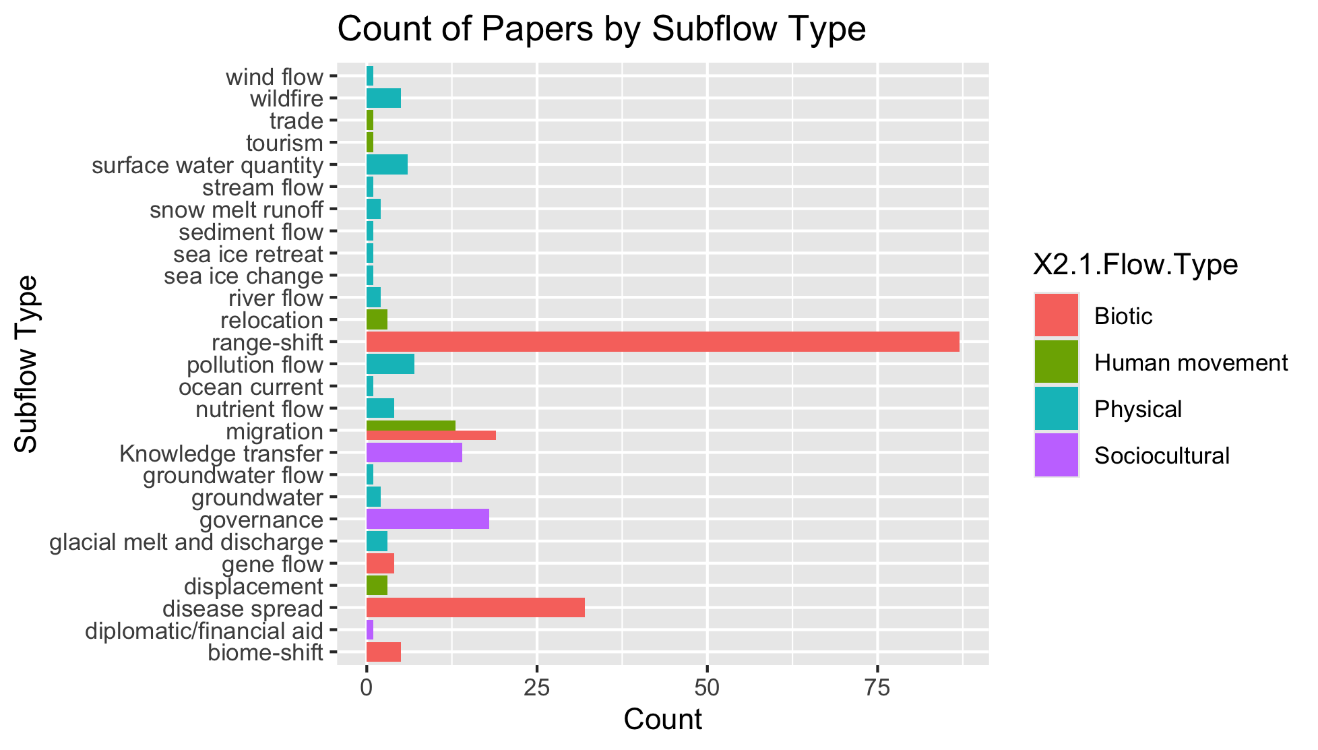
To group physical flow papers

Slide 30
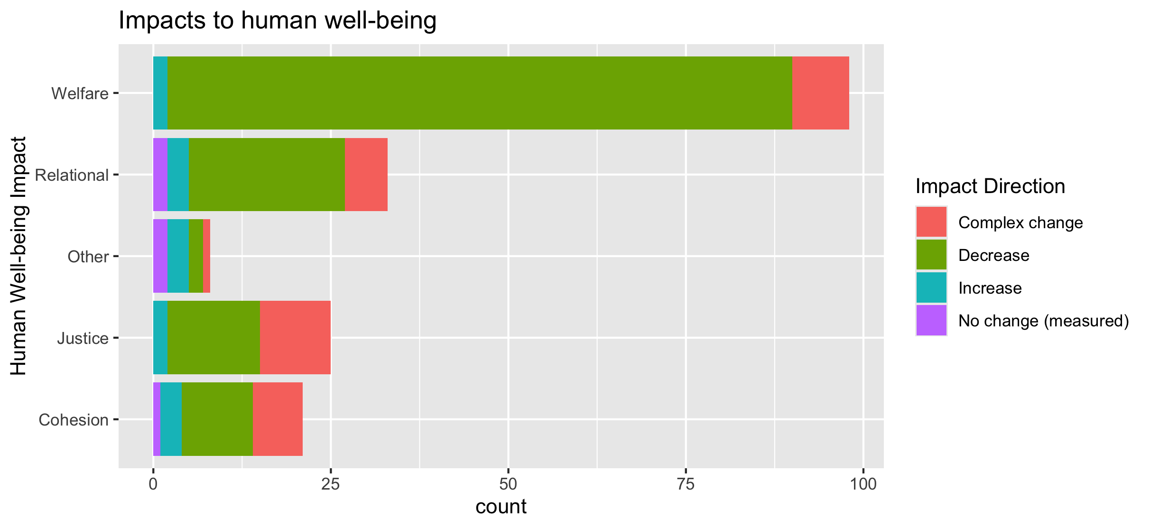
To align direction colors with final color pallet

Slide 31
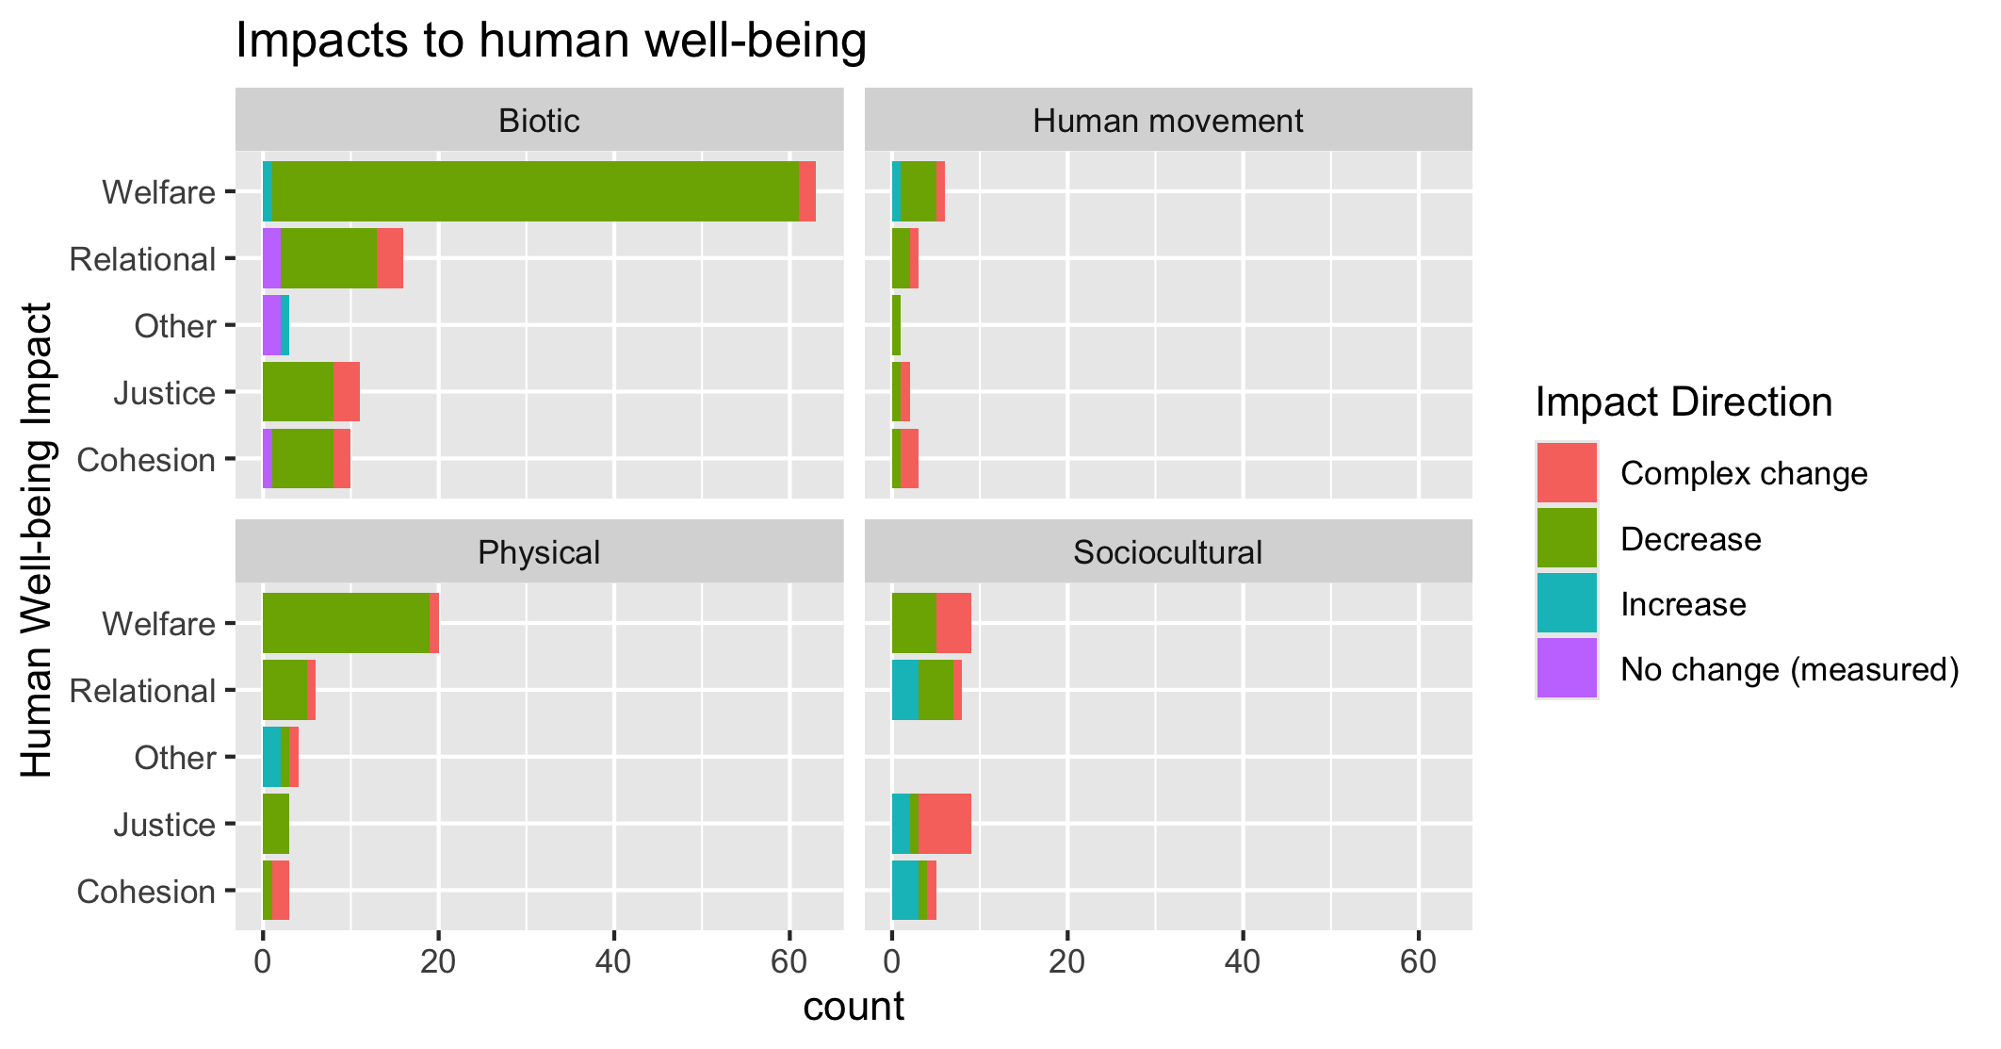
To align direction colors with final color pallet

Slide 32
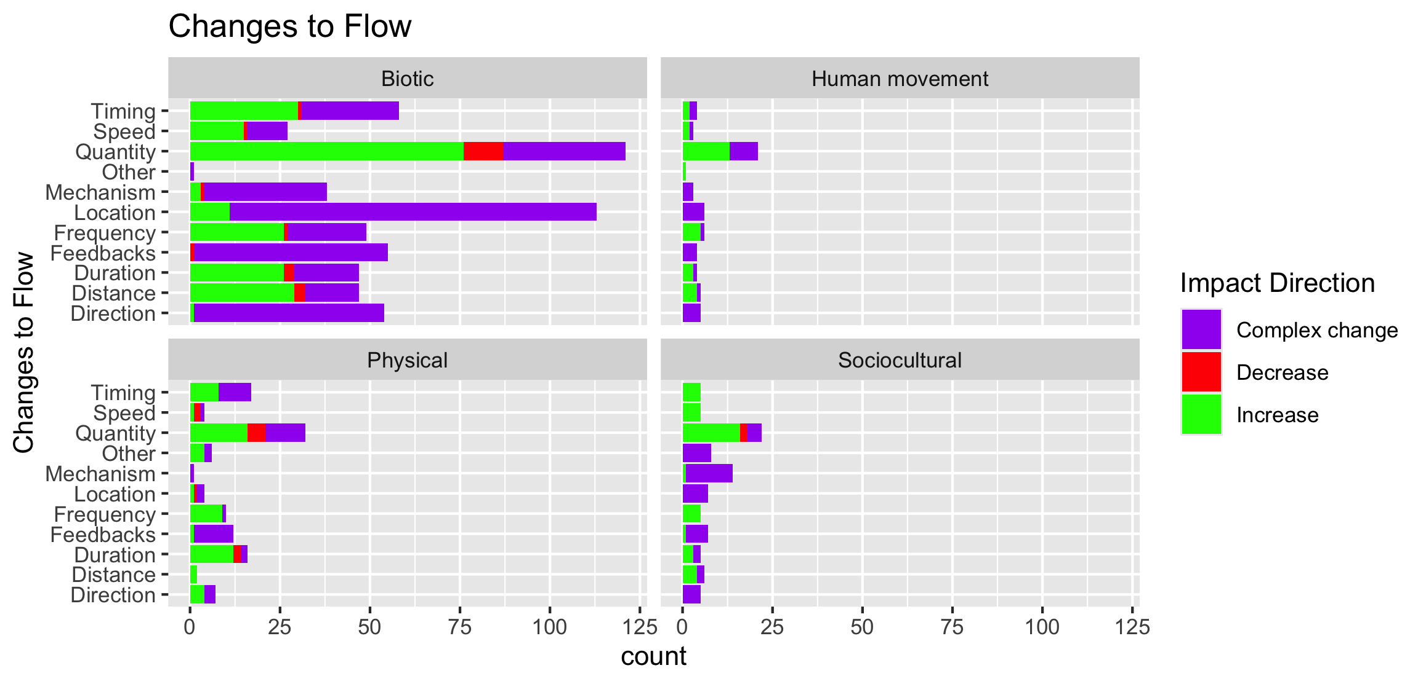

Slide 33
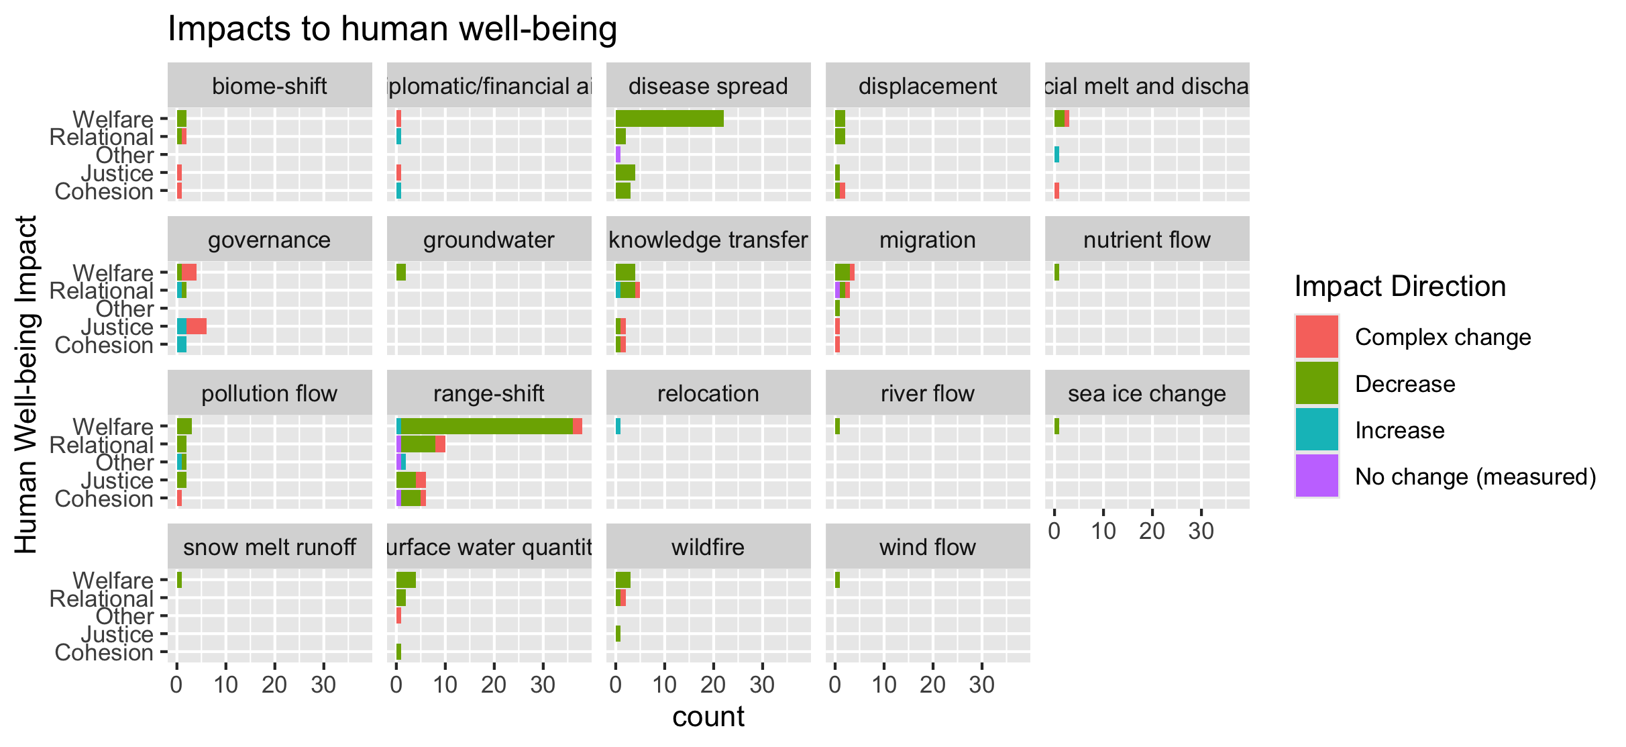
To group physical flow papers

Slide 34
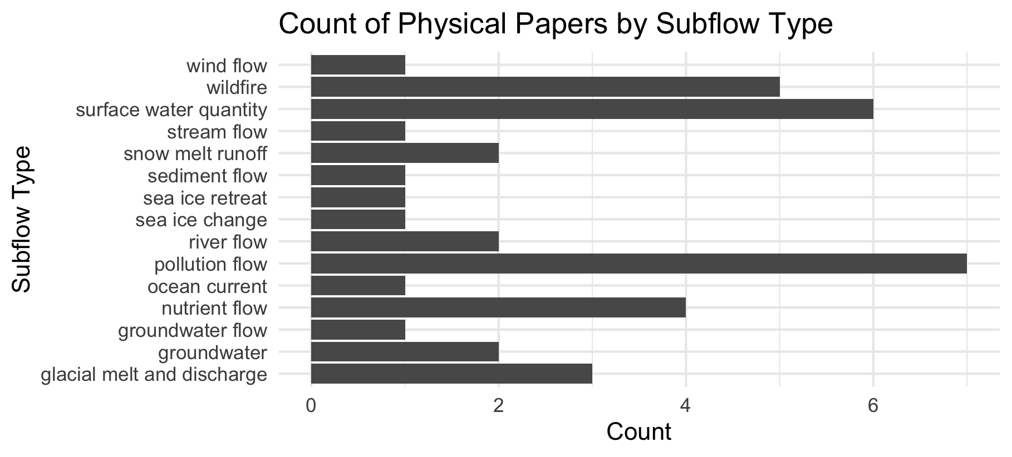

Slide 35
Feb 23 2025

Slide 36
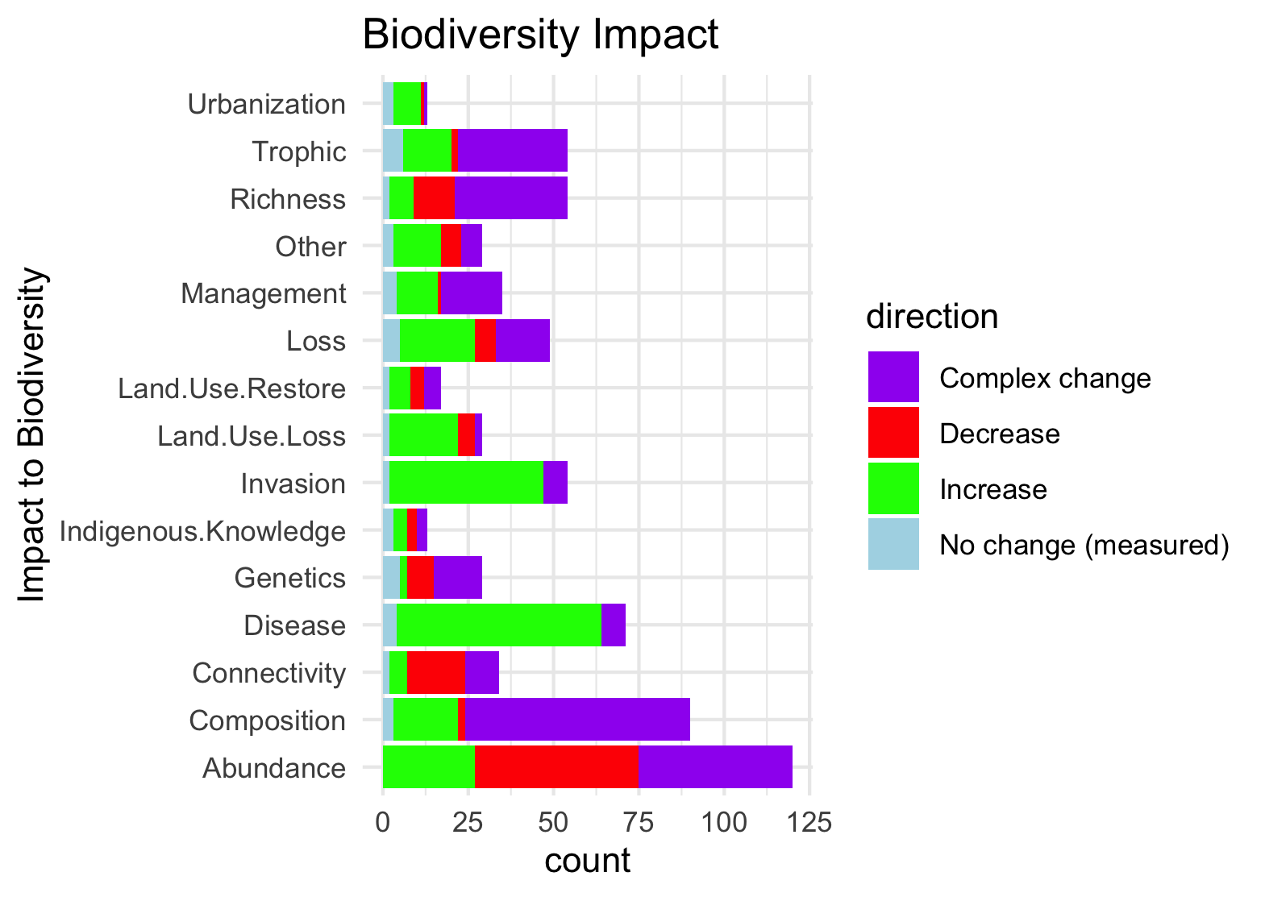
Needs to be grouped by what is good and what is bad to see increase in:

Slide 37
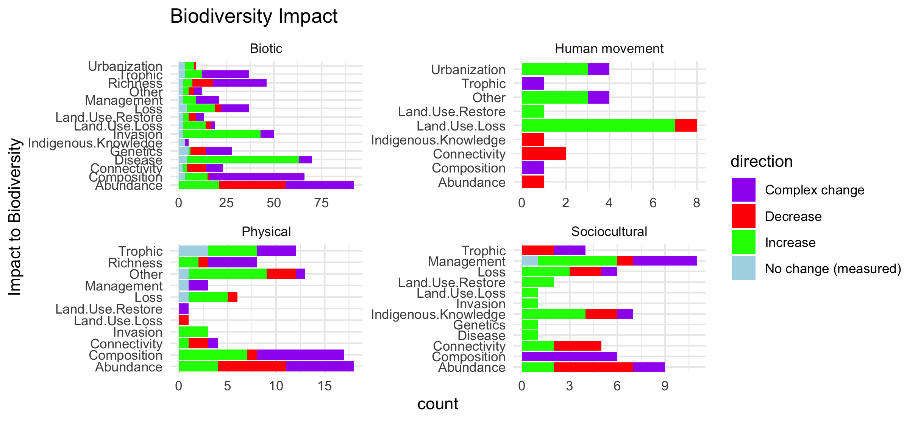
Scale free on the facet (diff x axis)

Slide 38
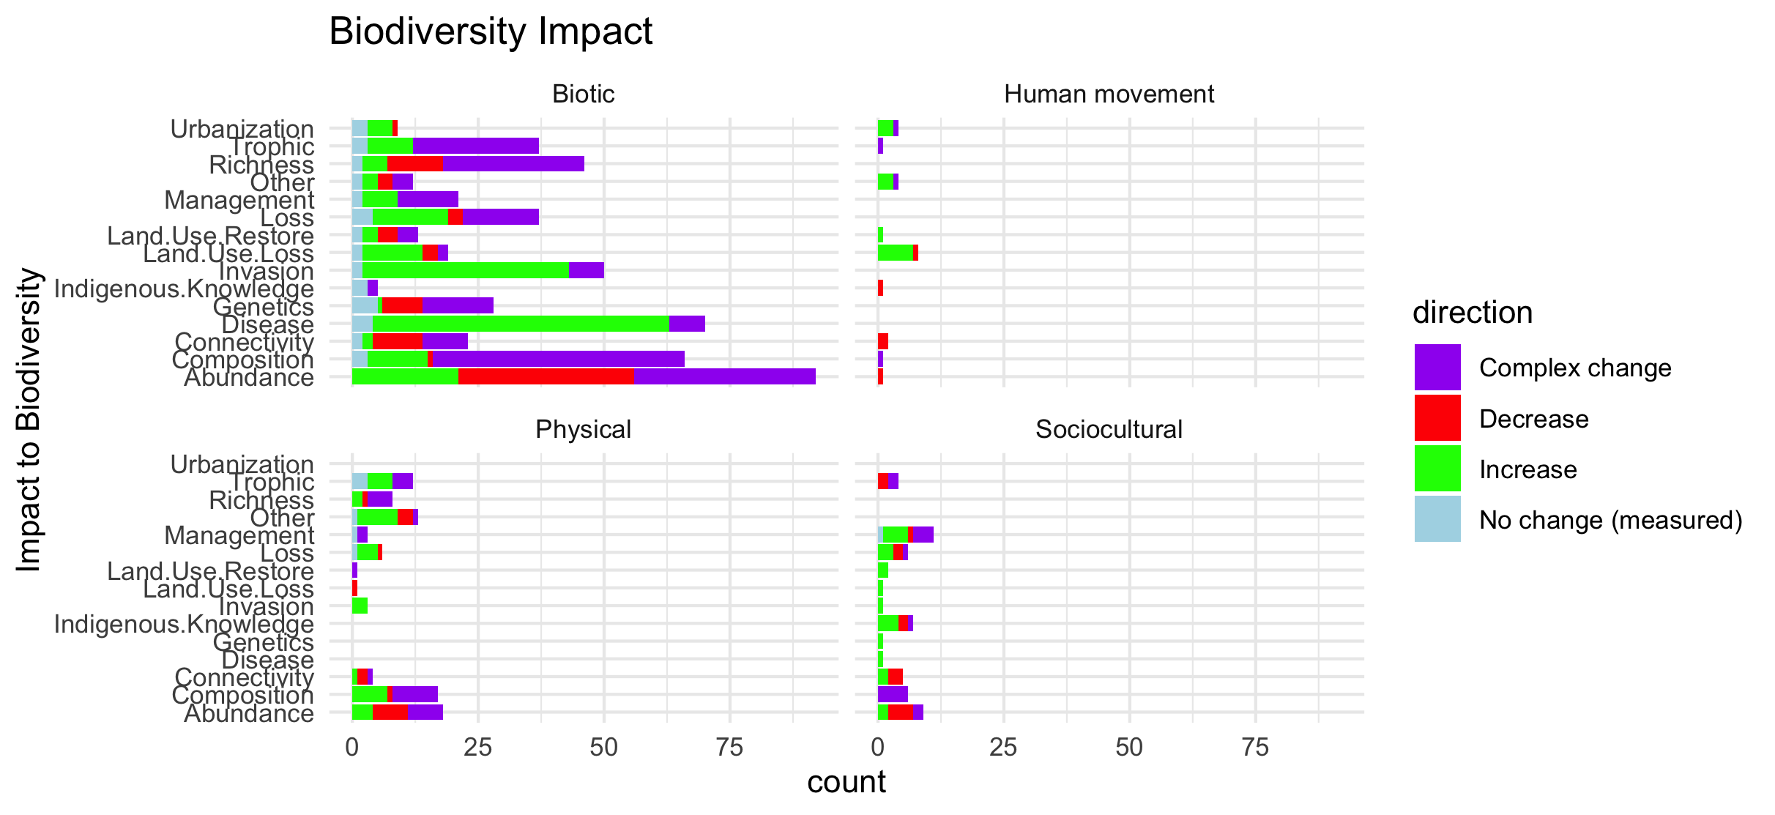
Scale fixed on the facet (same x axis)

Slide 39
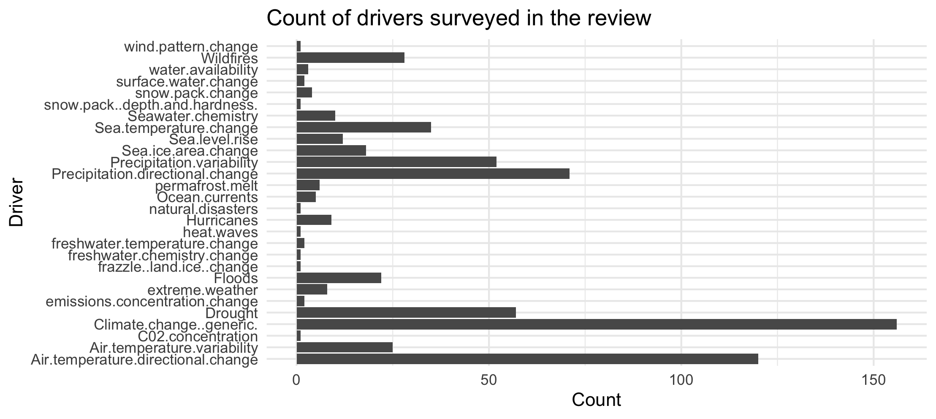

Slide 40
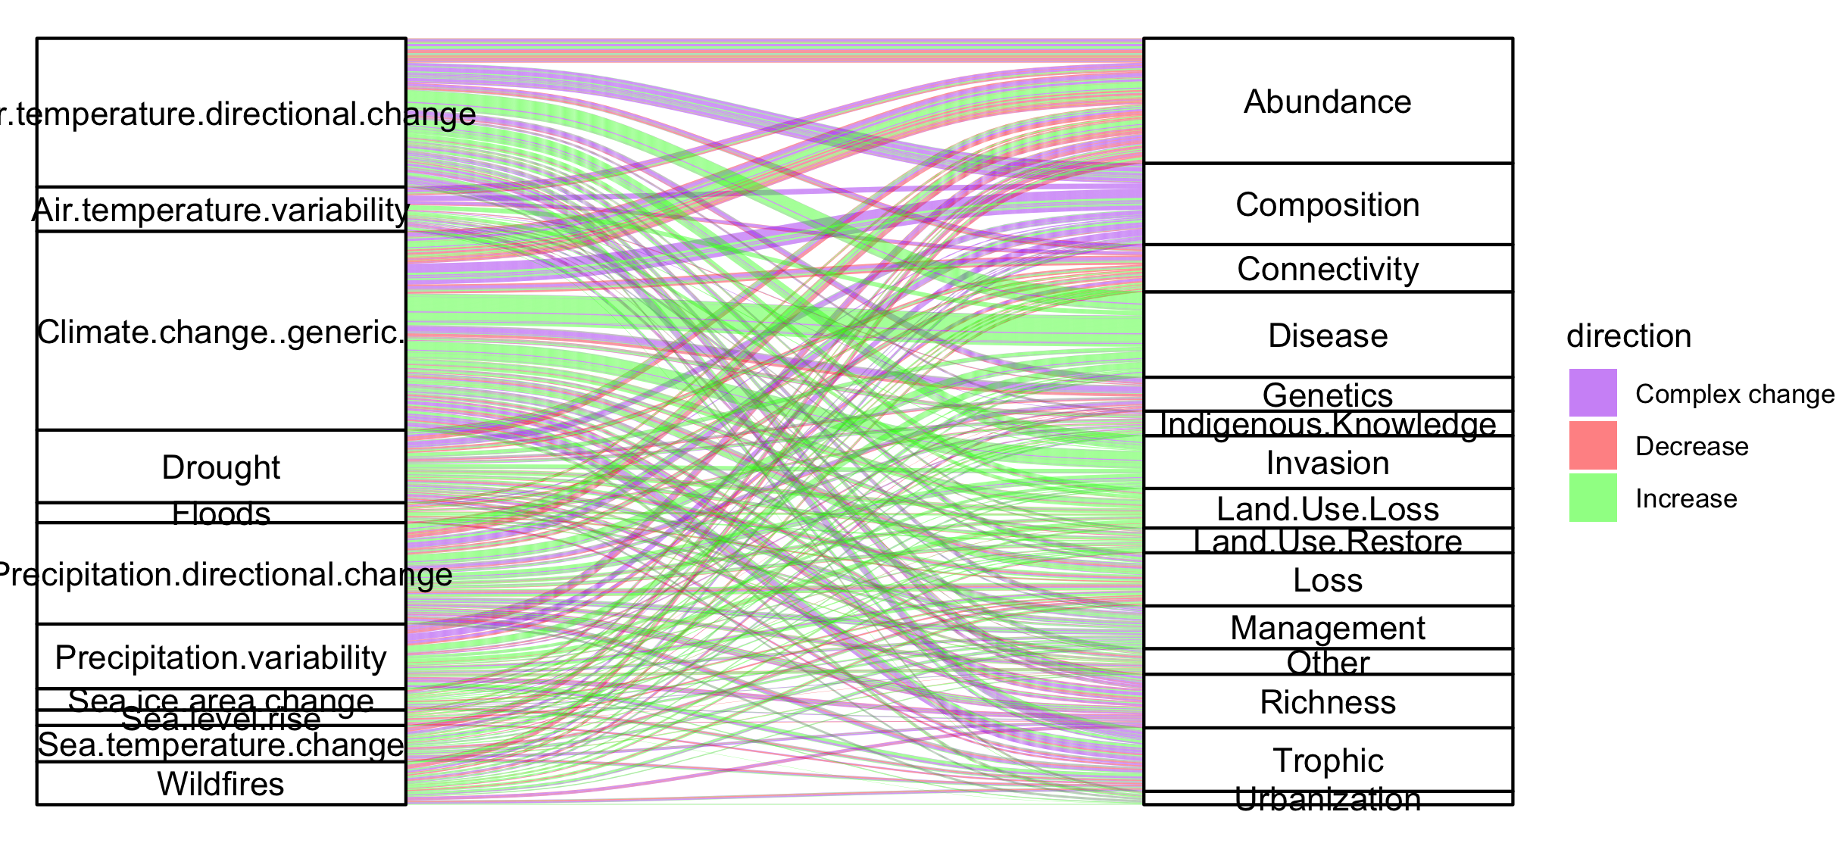
Colleen: see note isn the code – we could group spme of the drivers (hurricaines, extreme weather, ands ome of the ice ones). This still doesnt take into account if changes arw good or bad though and might just be too busy.

Slide 41
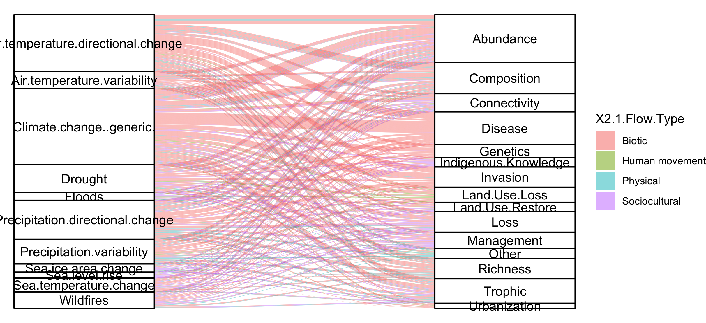
#not that informative because so many more of the papers are biotic

Slide 42
NCPs

Slide 43
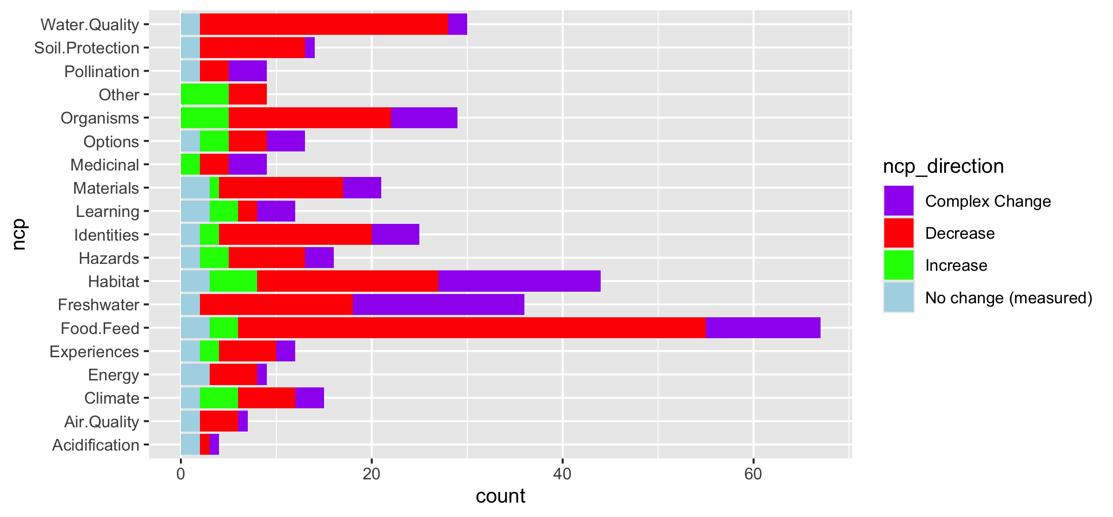
Fix labels

Slide 44
Do by flow type

Slide 45
Fix labels

Slide 46
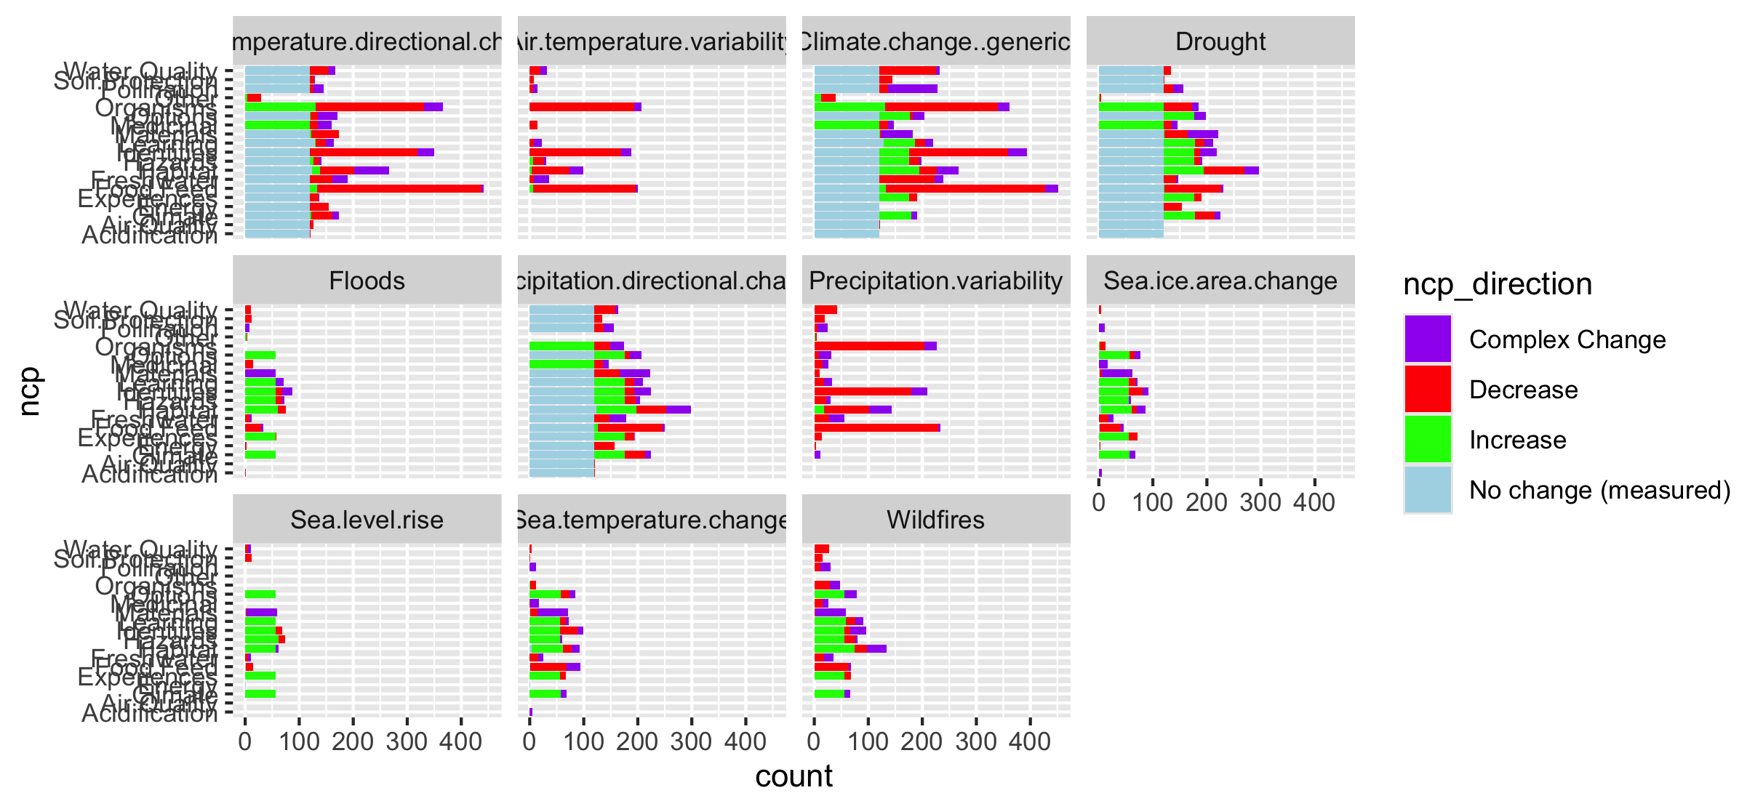

Slide 47
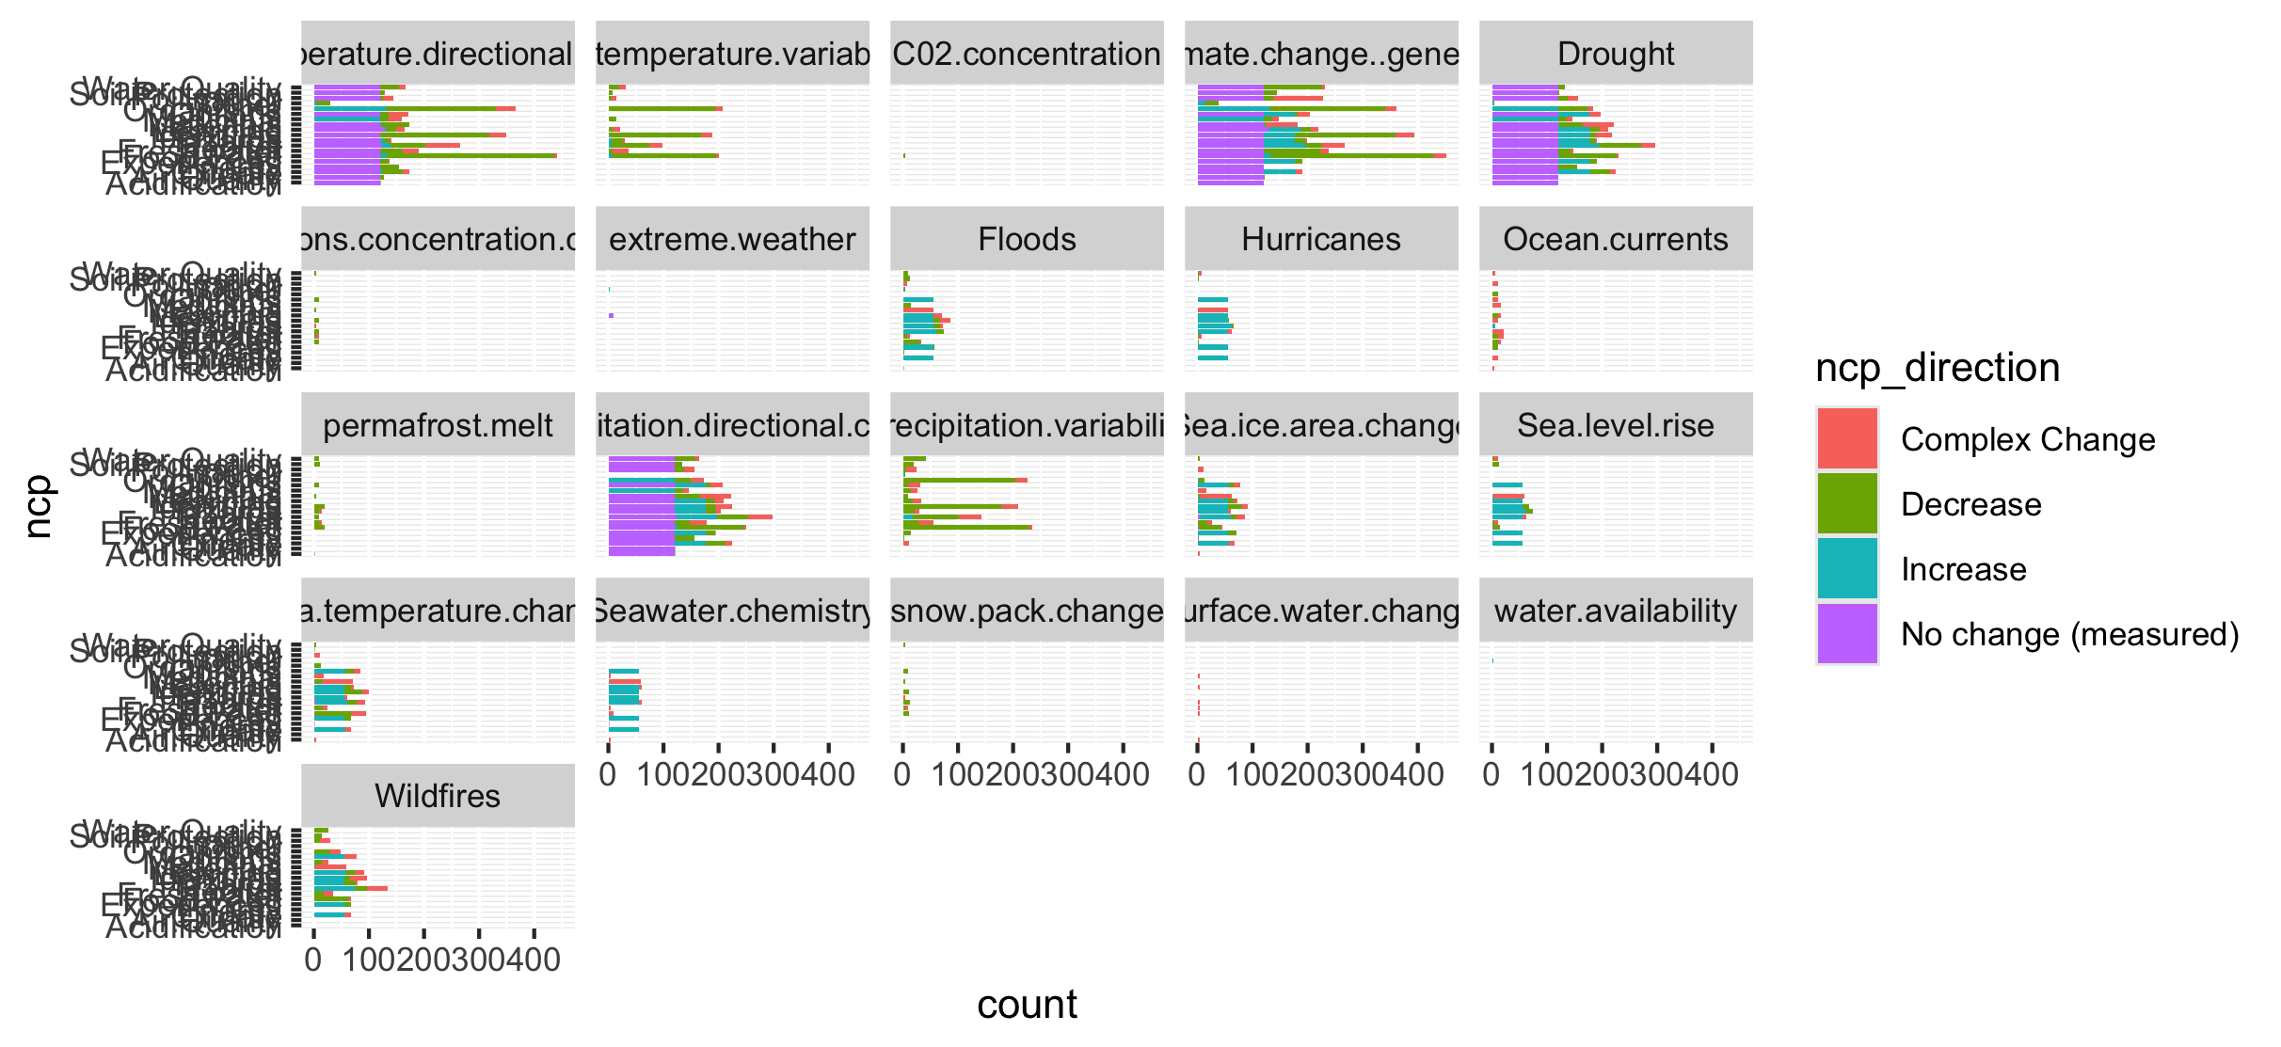
Too many drivers

Slide 48
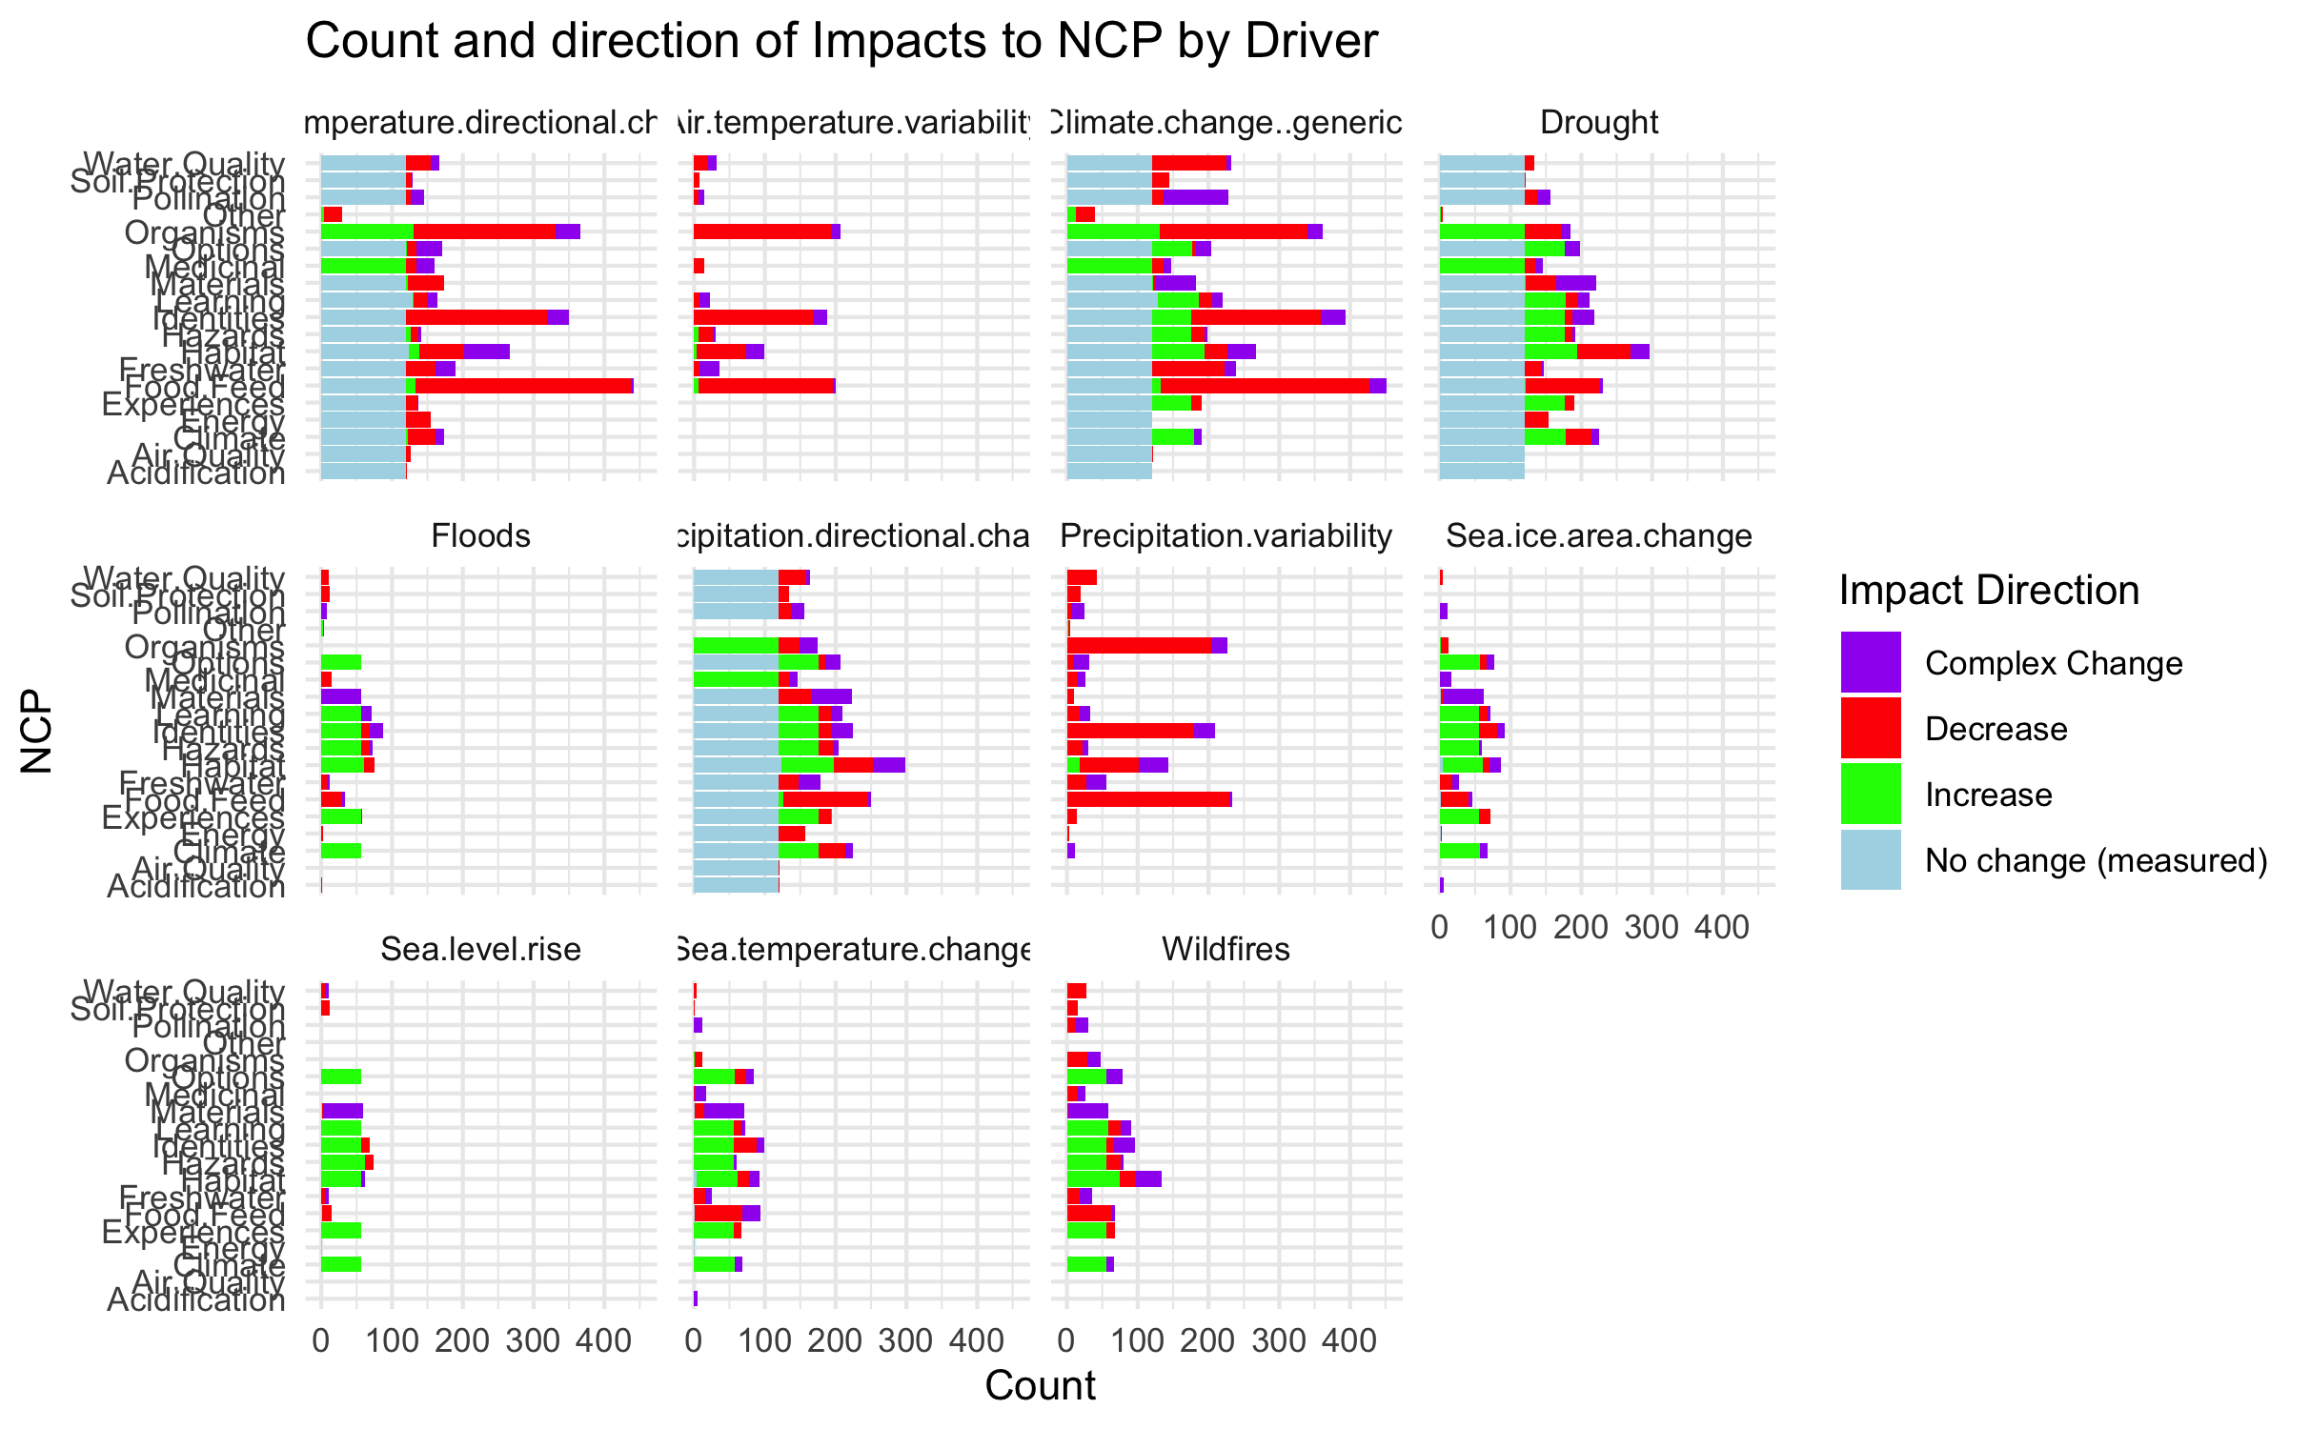

Slide 49
HWB

Slide 50
Connections – how does altered flow relate
Driver~ altered flow (by flow, and subflow – grouped out by flow
Altered flow~ impact (for each category)

